Slide 1
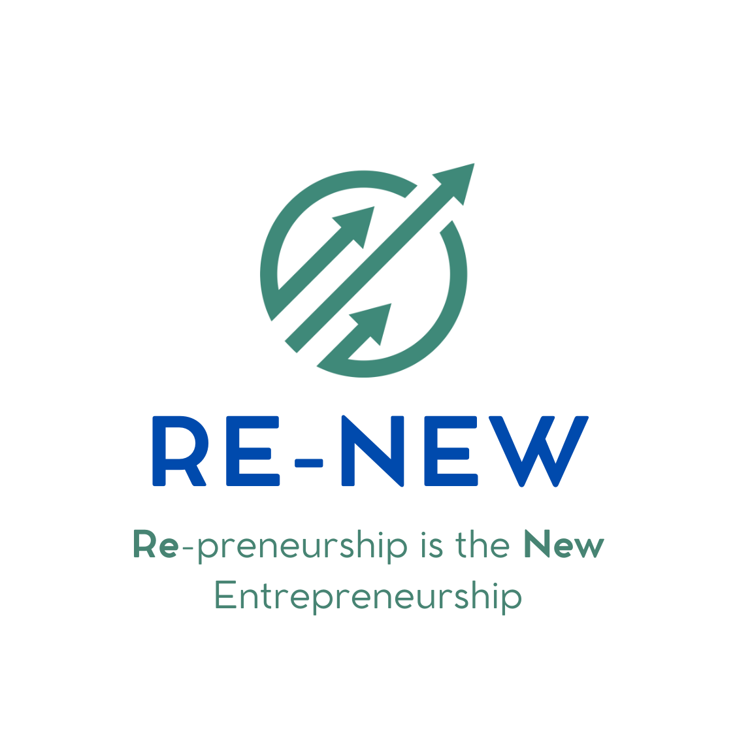




ICP Day – Oral Defense
June 5, 2025
https://www.re-new.team/
https://www.linkedin.com/company/re-new-reprenez-transformez/
contact@re-new.team
Confidential – Re-New - 2025

Slide 2
Company Purpose
Preserving economy by facilitating micro-cap SME transmission and accelerating their digital and environmental transformation
Problem
Mission
Vision
Fragmented, complex, inefficient SME transmission market
Accelerating SME transmission
Become the Y Combinator for SME transmission
Notes:
Bertrand
Our purpose is clear and bold: to transform the way small and mid-sized businesses change hands and develop, in France and, soon, across Europe. Our mission is to make SME succession not just possible, but successful.
The problem : Fragmented, complex, inefficient SME transmission market, where buyers lack support to succeed and fail 40% of attempts, and sellers struggle to find the right buyers.
Our service: Accelerating SME transmission through rigorous selection, preparation and customized support of individual SME buyers, to make SME succession not just possible but successful and impactful
We believe that every business transition is an opportunity for sustainable growth and positive change, and we’re here to orchestrate that transformation at scale
Our vision: Become the Y Combinator for SME transmission in Europe, which means become one of Europe’s leading accelerators/investment funds within the next 10 years, dedicated to supporting individual repreneurs and investing in SME transmission opportunities across the continent.

Slide 3




Why now ?
The perfect storm for SME transmission: we are at the crossroads of several powerful trends, and the process remains complex and under-served.
DEMOGRAPHIC TRENDS
SUCCESSION WAVE
40% French SMEs without transmission plan
65% owners > 60 in 2030
UNDERSERVED MARKET
NEW GENERATION OF BUYERS
Dynamic & fragmented Micro-cap M&A market
Entrepreneurship with less risks attached
Notes:
New
The timing for Re-New couldn’t be better: market trends show a growing market.
First, Europe and in particular France is facing a major demographic shift: around 60% of SME owners are over 60, meaning that many businesses will require new leadership by 2030.
Second, family-led successions are declining. Almost 40% of French SMEs have no internal successor, highlighting a critical gap in business continuity.
Meanwhile, the Small Cap M&A market is growing rapidly across France and Europe, with over 400,000 businesses changing hands each year. However, many of these transfers fail, mainly due to the complex, fragmented nature of the process, especially for individual buyers.
Into this landscape steps a new generation of buyers. They’re motivated by independence, long-term ownership, and impact, often driven by ESG principles. They come from diverse backgrounds, from corporate strategy and finance, to startups, and see acquisition as a faster, less risky path than launching a business from scratch.
These converging trends create a unique window of opportunity for a platform like Re-New to professionalize and orchestrate the SME transmission ecosystem. We serve as a much-needed bridge, unlocking value for sellers, empowering the next generation of owners, while supporting business continuity and sustainable growth across France and Europe.

Slide 4
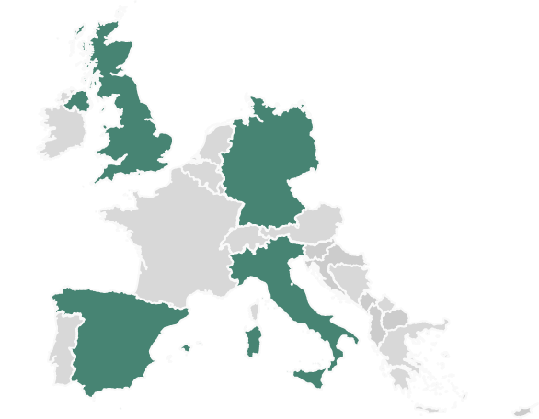




Market size
A large opportunity in France, and also across Europe
Europe SAM¹
3 500 / year
TAM = 60 000 / year
1 500 / year
SAM = 7 000 / year
1 250 / year
SOM = 35 / year
1 000 / year
~15 000 transactions / year
¹The European small business finance outlook - https://www.eif.org/news_centre/publications/eif-working-paper-2024-101.pdf
Notes:
Amelie
“The opportunity is immense, in France and also across Europe, and as we said previously, in a growing market.
In France alone, there are 60,000 SME sales annually, with around 14,000 deals in the €1–10M range—the micro-cap segment we target.
Of these, around 7,000 involve individual buyers, our primary audience. Even with a modest 0.5% of the market, Re-New could take part to 35 deals per year in France
This segment is growing, driven by demographic shifts, owner retirements, and a rising appetite for entrepreneurship through acquisition.
Our approach is scalable across Europe, where similar trends and gaps exist. If we capture even a modest share of this market, the upside is substantial, both in terms of impact and financial return.
Our SAM across Europe is as high as 15 000 deals per year, with Germany, Italy and Spain as key priorities to investigate.
Our business model is designed to scale as the market grows, with clear pathways to expand into new geographies and adjacent services.”

Slide 5



Problem
An overly inefficient SME transmission market
impacting negatively all stakeholders
-Lack of preparation
-Difficulty to find suitable successor
Missed opportunities
-A fragmented and opaque deal flow
-An overwhelming process
-Isolation & lack of support
Sellers
Buyers
-Difficulty to find bankable buyers
-De-risk portfolio
Value loss
Investors
Notes:
Catherine
Thousands of micro-cap SMEs face a broken succession process that harms everyone. Aspiring buyers confront fragmented, opaque deal flow—aware a business is for sale but unable to access reliable off-market opportunities. Even when a target emerges, the acquisition journey overwhelms: valuations, due diligence, legal negotiations, and financing fall entirely on their shoulders without clear guidance. Many promising buyers abandon their search, deterred by complexity and cost.
Meanwhile, SME owners often lack any succession plan or timeline. Finding and preparing a suitable successor becomes a daunting task. Without professional guidance or access to a vetted buyer pool, owners risk handing their life’s work to someone unprepared—or closing down entirely.
Investors—banks, private equity, and family offices—also struggle. They cannot easily vet which buyers are truly “bankable,” creating mistrust around a buyer’s ability to close the deal and run the business. With limited visibility into buyer readiness, investors hesitate to underwrite transactions, making financing scarce or prohibitively expensive. Many potential deals never materialize.
Together, these factors lead to missed opportunities and value loss. Buyers drop out, sellers retire without a proper handover, and investors sit on the sidelines. The result: viable businesses shut down, jobs vanish, and local economies suffer, threatening the continuity of thousands of SMEs.

Slide 6



Solution
The first structured acceleration program,
connecting buyers, partners, experts and investors
Multi-step proprietary selection process
Modular acceleration program
Increase probability of target search success
Improve negotiation outcome
Improve financing conditions
Support company « grey-to-green » transformation
Attract & select the best
Connecting with partners
Sustainability fully anchored from candidate selection to value creation
Notes:
Catherine
Re-New rigorously vets aspiring repreneurs—those with industry experience, leadership skills, and commitment to long-term value. This essential filtering focuses resources on buyers most likely to succeed.
Selected candidates gain access to a curated pipeline of vetted, off-market SMEs. No more fragmented searches—deal sourcing becomes predictable, an antibiotic against endless hunting.
Each repreneur receives one-on-one coaching from seasoned operators and experts, covering valuation, negotiation tactics, and operational blueprints. Parallel to coaching, a network of trusted legal and due-diligence partners streamlines contracts, compliance, and risk management—replacing expensive, piecemeal advisor patchwork.
Financing is woven into the journey: through established relationships with banks and alternative lenders, we secure bankable terms that dramatically reduce capital uncertainty. Without Re-New, buyers drive blind; with us, it’s a focused, lower-risk path to closing.
Finally, support continues post-acquisition with ongoing coaching on digital modernization and ESG integration. This “grey-to-green” transformation unlocks value, turning each acquisition into a force for community and environmental good. Re-New isn’t a nice-to-have aspirin—it’s the antibiotic the SME succession ecosystem desperately needs.

Slide 7
Coopetition – Partners and soon to be partners
A highly fragmented and analogic market
with potential for offer aggregation and digitalization
Training
Project clarification
Coaching
Target Research
Due Diligence
Financing
Legal & closing
Post acquisition support
Indirect competitors
Direct competitors
Re-New & partners
+
Existing partners
# of players involved
To be installed
-
Notes:
Francesca
The SME transmission landscape is highly fragmented. Along the journey that each repreneur must follow, from training and project clarification to financial, legal, and post-acquisition, numerous actors are present.
These actors can be seen as indirect competitors for Re-New, such as legal and accounting firms as well as para-public, associations and repreneurs’ networks.
Others, such as banks, M&A firms, deal brokers or platforms, may be considered direct competitors. However, none of them covers all the stages of the repreneurship journey.
Re-New is here to fill this gap.
Rather than competing with every player in the field, we integrate and collaborate, even with former competitors, to build a value-added ecosystem that combines rigorous deal selection with modular end-to-end support to make the acquisition journey even more effective, accessible, and impactful.

Slide 8
Product Development roadmap
Q2 25
Q3 25
Q4 25
S1 26
S2 26
S1 27
12
15
20
Build & scale Acceleration Programme
Operating Partner & Advisory model
Education & Training model
2,000
6,000
9,000
Grow community
Test Accelerator & Fund models
Go / No-go
Notes:
Bertrand
A more detailed roadmap in appendix
Acceleration : our acceleration programme is at the core of Re-New ; continuous improvement of our processes, automation and digitalization are part of our plans to scale it. So is the growth of monetized partners, we plan to grow from 9 today, to 20 in 27
Advisory : The Operating Partner model is gaining traction in Europe, we do need to test this and build a small community of SME experts to help buyers create value. Also, we need to position Re-New as a trusted board member of SMEs acquired by our candidates
Training: only a handful of organizations provide repreneurship training, we believe that a solid and recognized program, endorsed by top-tier business school would be a key differentiator, and we plan to deliver on this
Long term vision: we have partners with whom we can test the accelerator model, and the fund model, we will capitalize as much as possible on this to try and create a very unique and new offer in the market

Slide 9
Business Model
A Business model with potential for diversification
to multiply monetization touchpoints and increase ARPU
Candidate selection
Training
Target Research
Deal closing
Financing
Post acquisition
Short term
Acceleration Model
Success fee
Success fee
Deal %
Deal %
Mid term
Advisory Model
Service fee
Education Model
usage fee
Long term
Accelerator / Fund Model
Deal %
Deal %
Management fees & carried interest
Notes:
Antoine:
A Business model with potential for diversification to multiply monetization touchpoints and increase Average Revenue Per User
Initiated acceleration model – currently proving monetization ; possible to sell candidates on-demand or monetize them at different touchpoints depending on the partner.
Then we have 2 service models we would like to test mid-term ; advisory model with operating partners post acquisition, and advisory board seats for the repreneurs
+ Education model, as it’s a very fragmented and inconsistent environment where associations, networks, and likedin gurus try to sell content ; and where potentially more can be done, with a rosk solid methodology backed by the best business school
Even though it’s a long term vision we will test it very rapidly, with the accelerator model and then the fund being our ultimate goal ;

Slide 10
Financials
We projected ambitious yet conservative financial targets
for our market entry, with a flexible cost-base
Revenue
CAGR
28%
K€ 710
2 education tracks in 2026, 20 in 2030
50 advisory days in 2026, 150 in 2030
K€ 260
Monetizing 11 candidates in 2026, 26 in 2030
EBITDA > 0 in 2027, Cash > 0 in 2028
Notes:
Antoine:

Slide 11
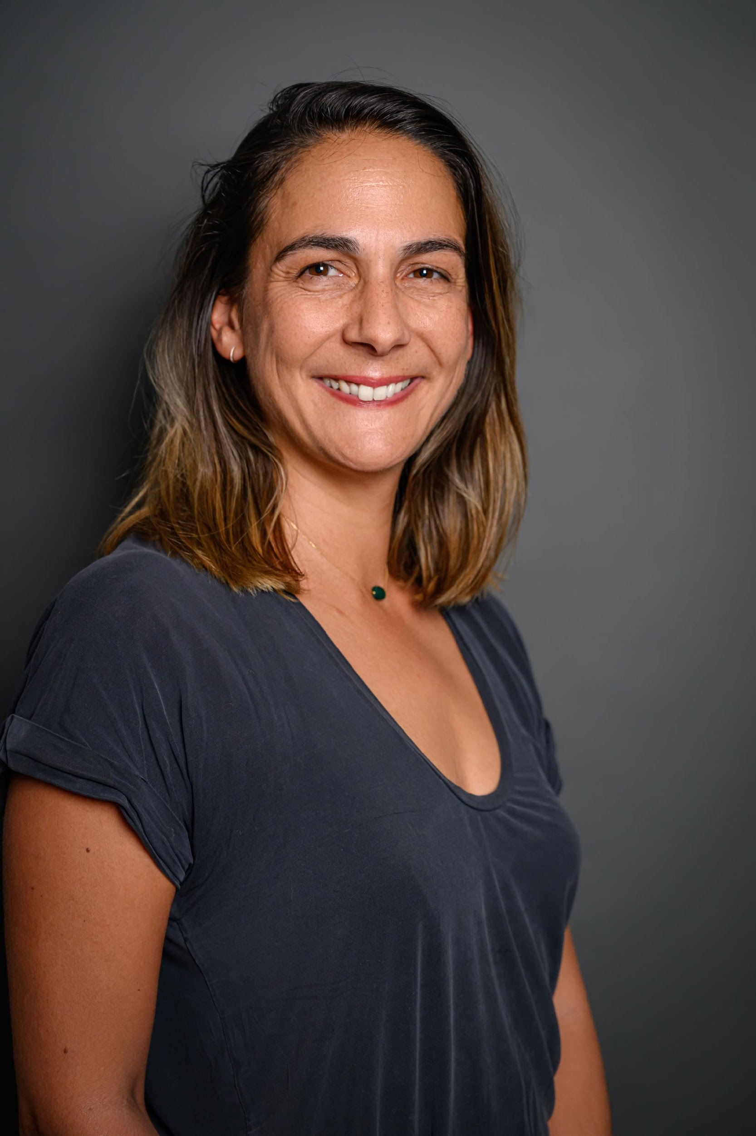
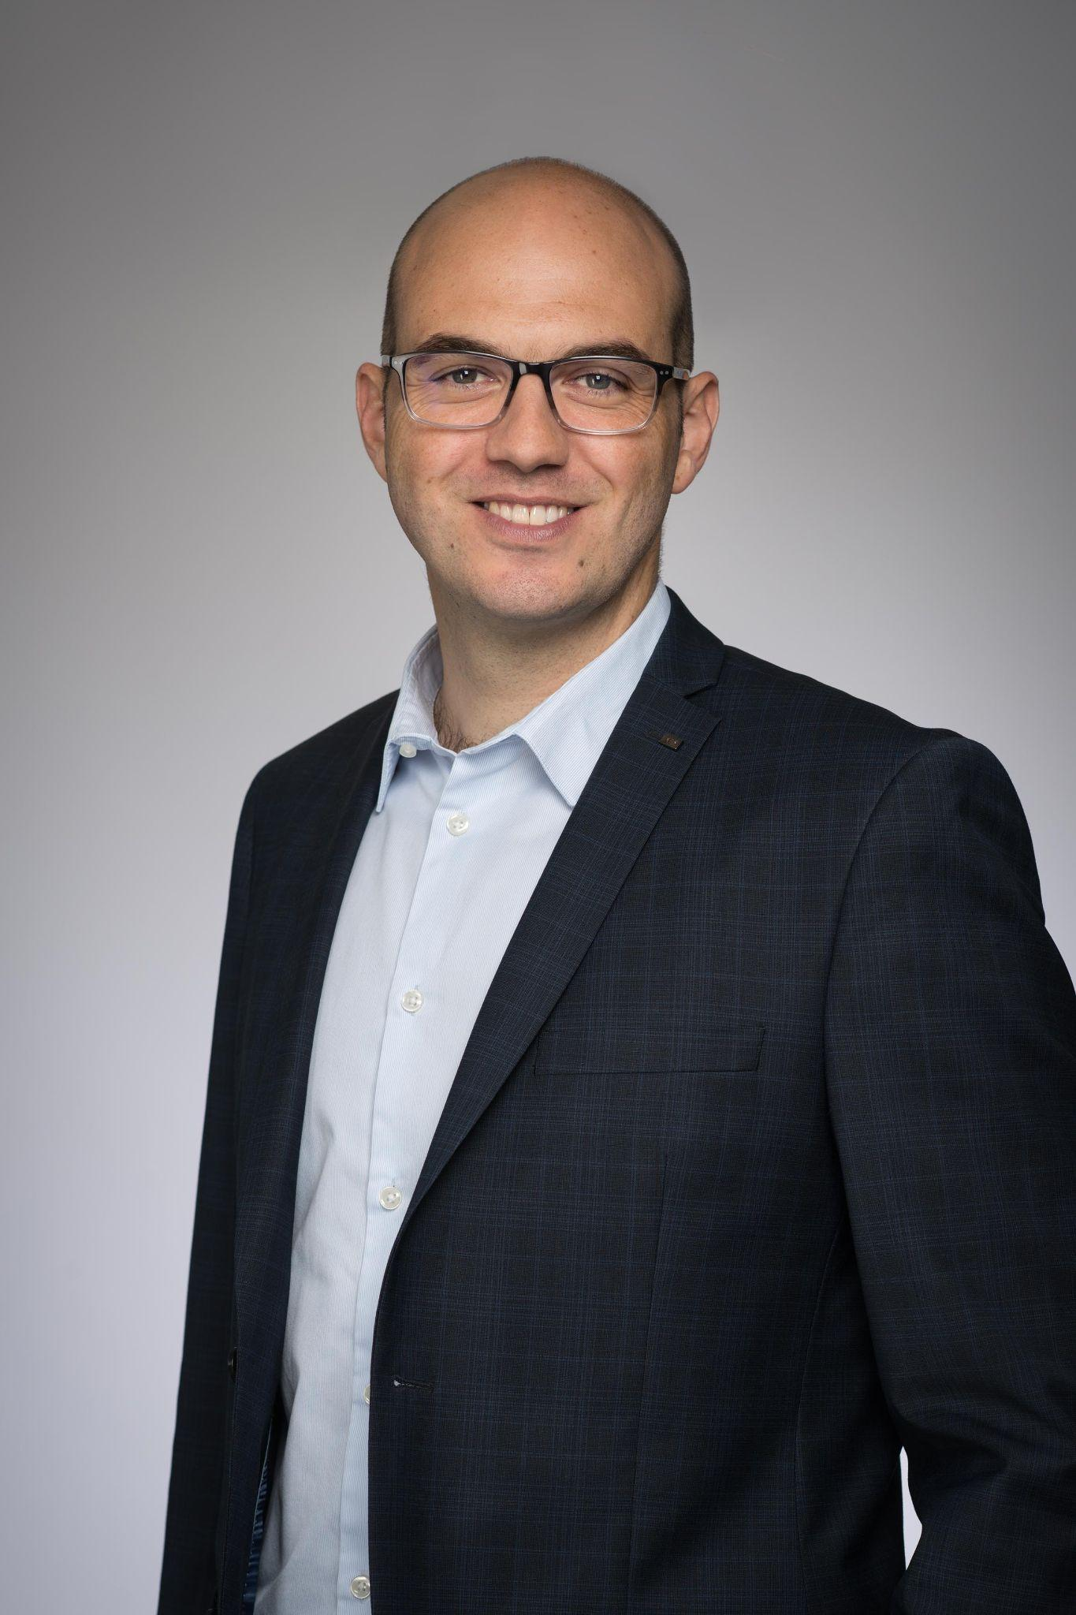
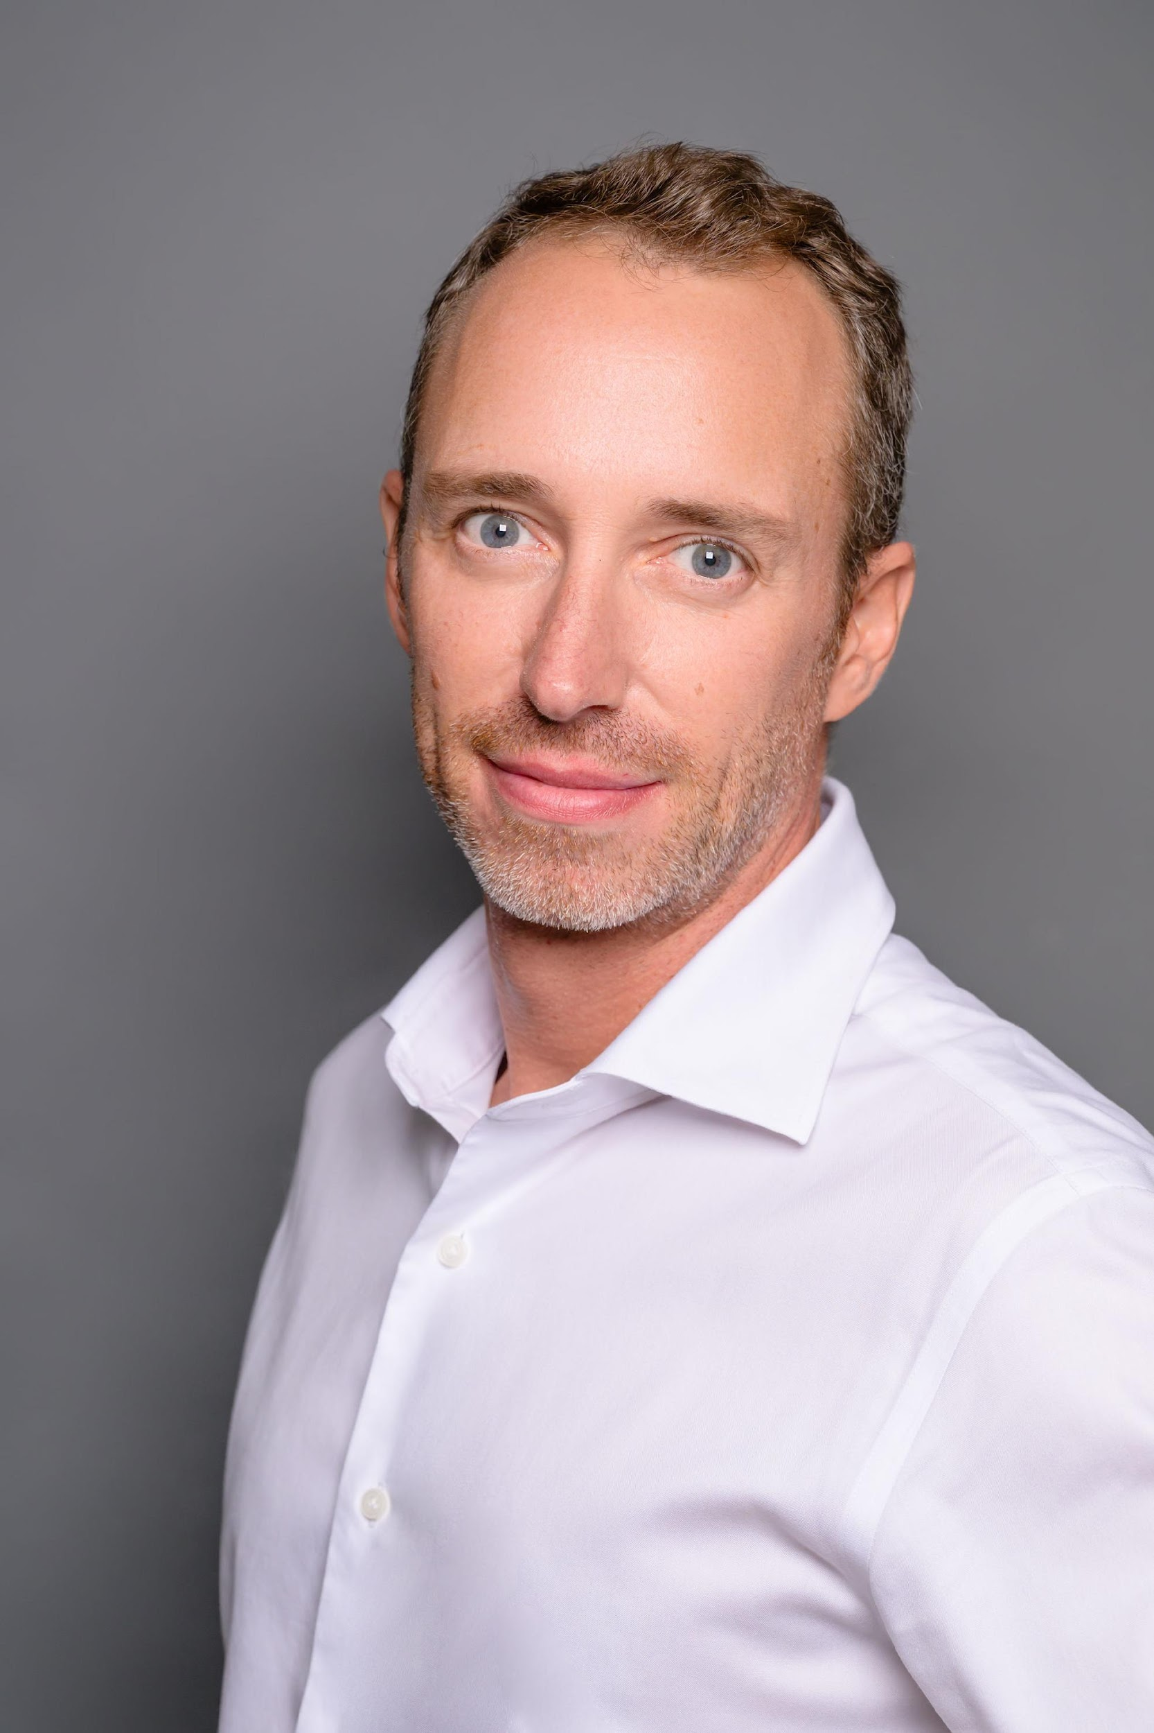
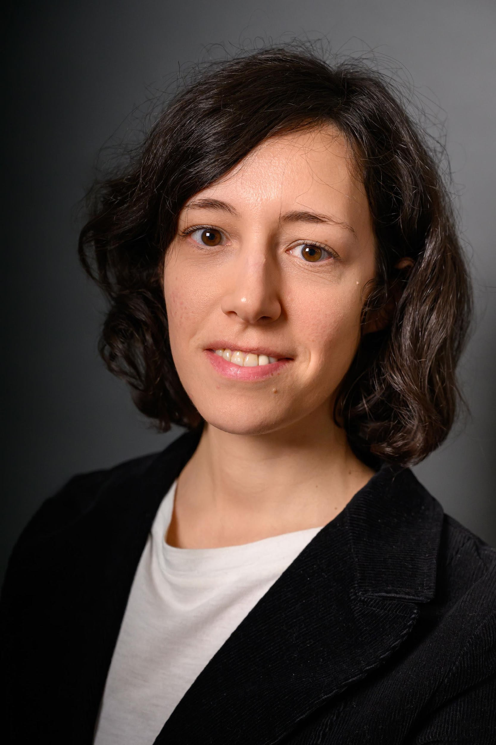
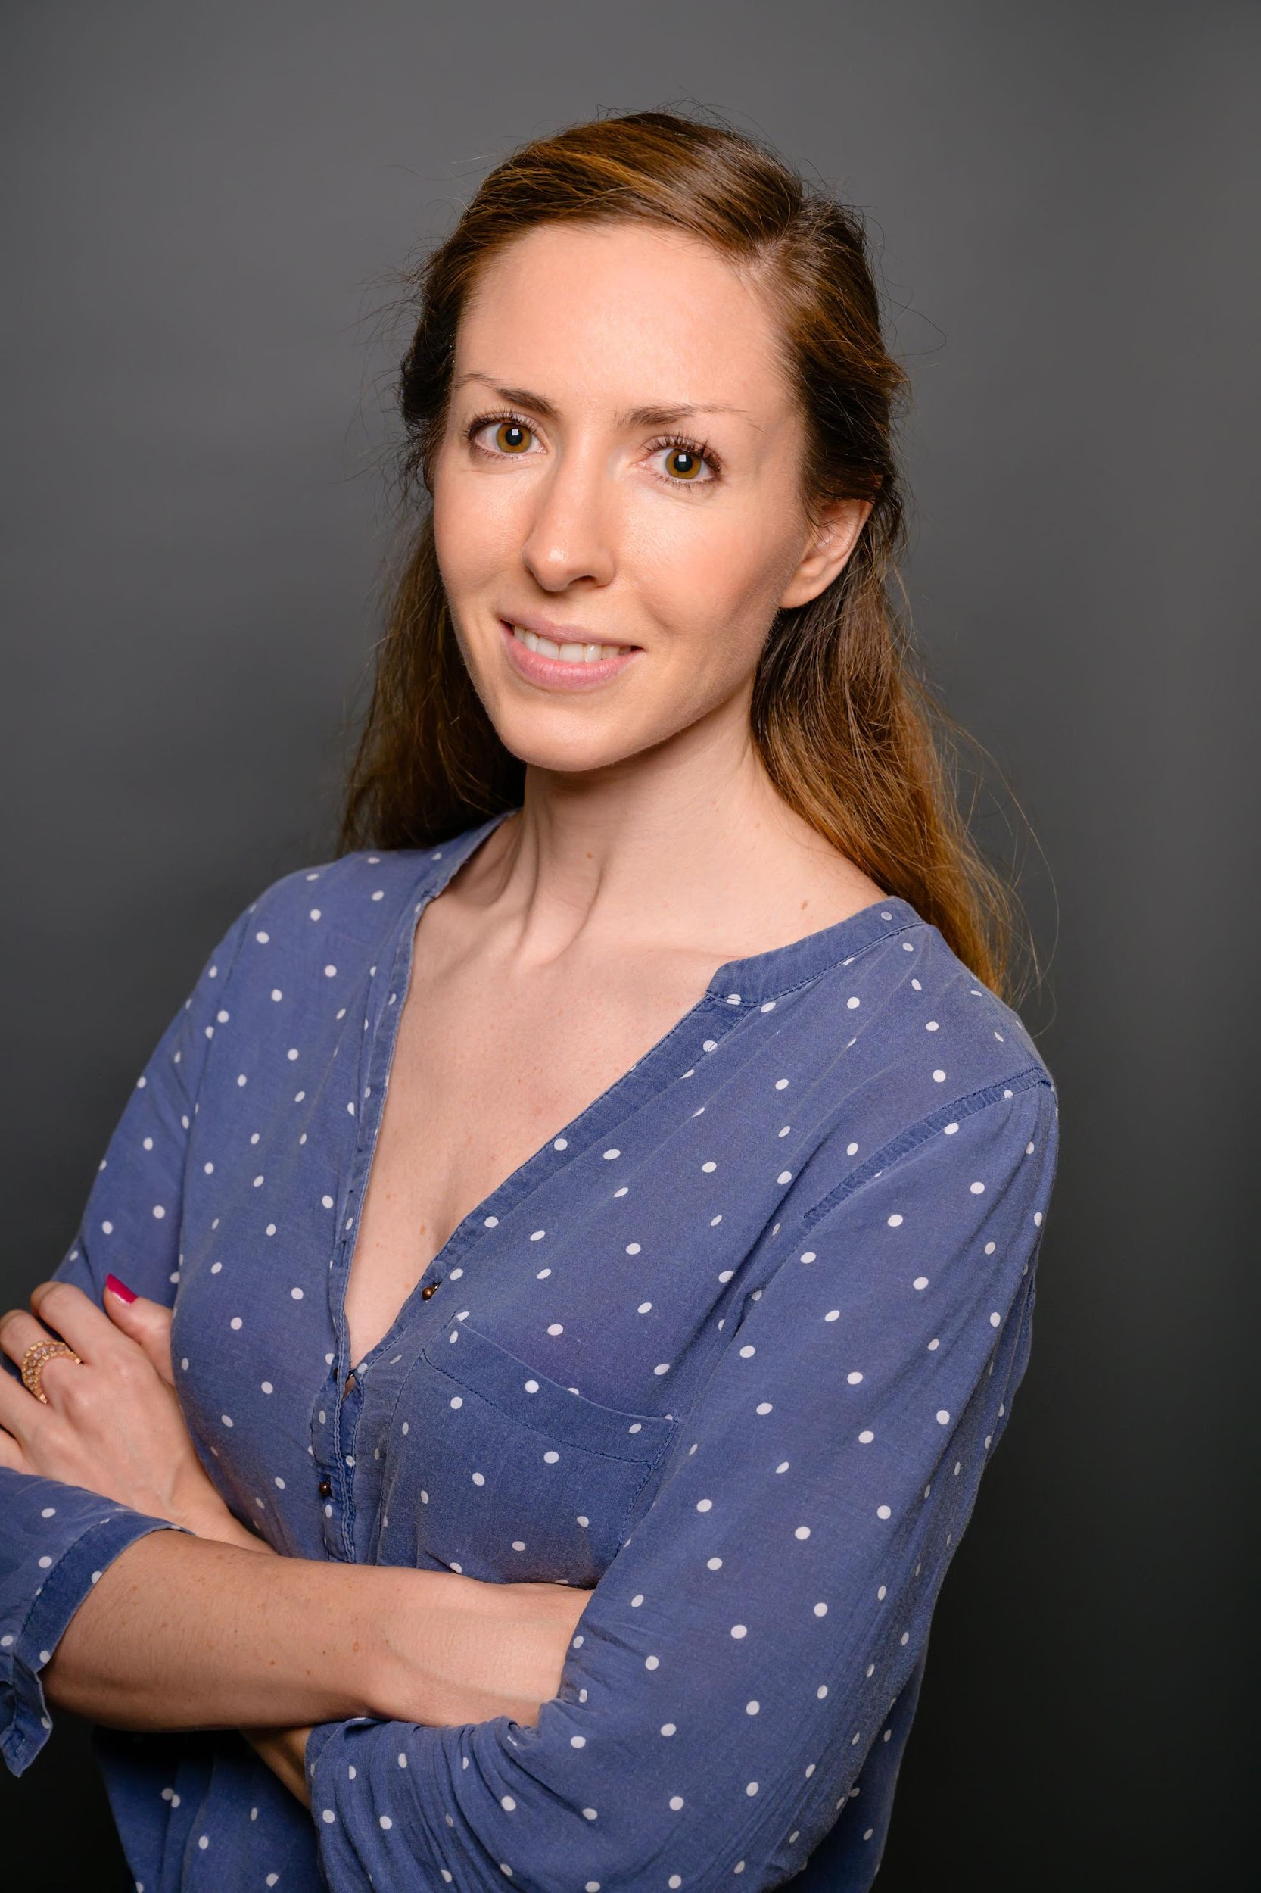
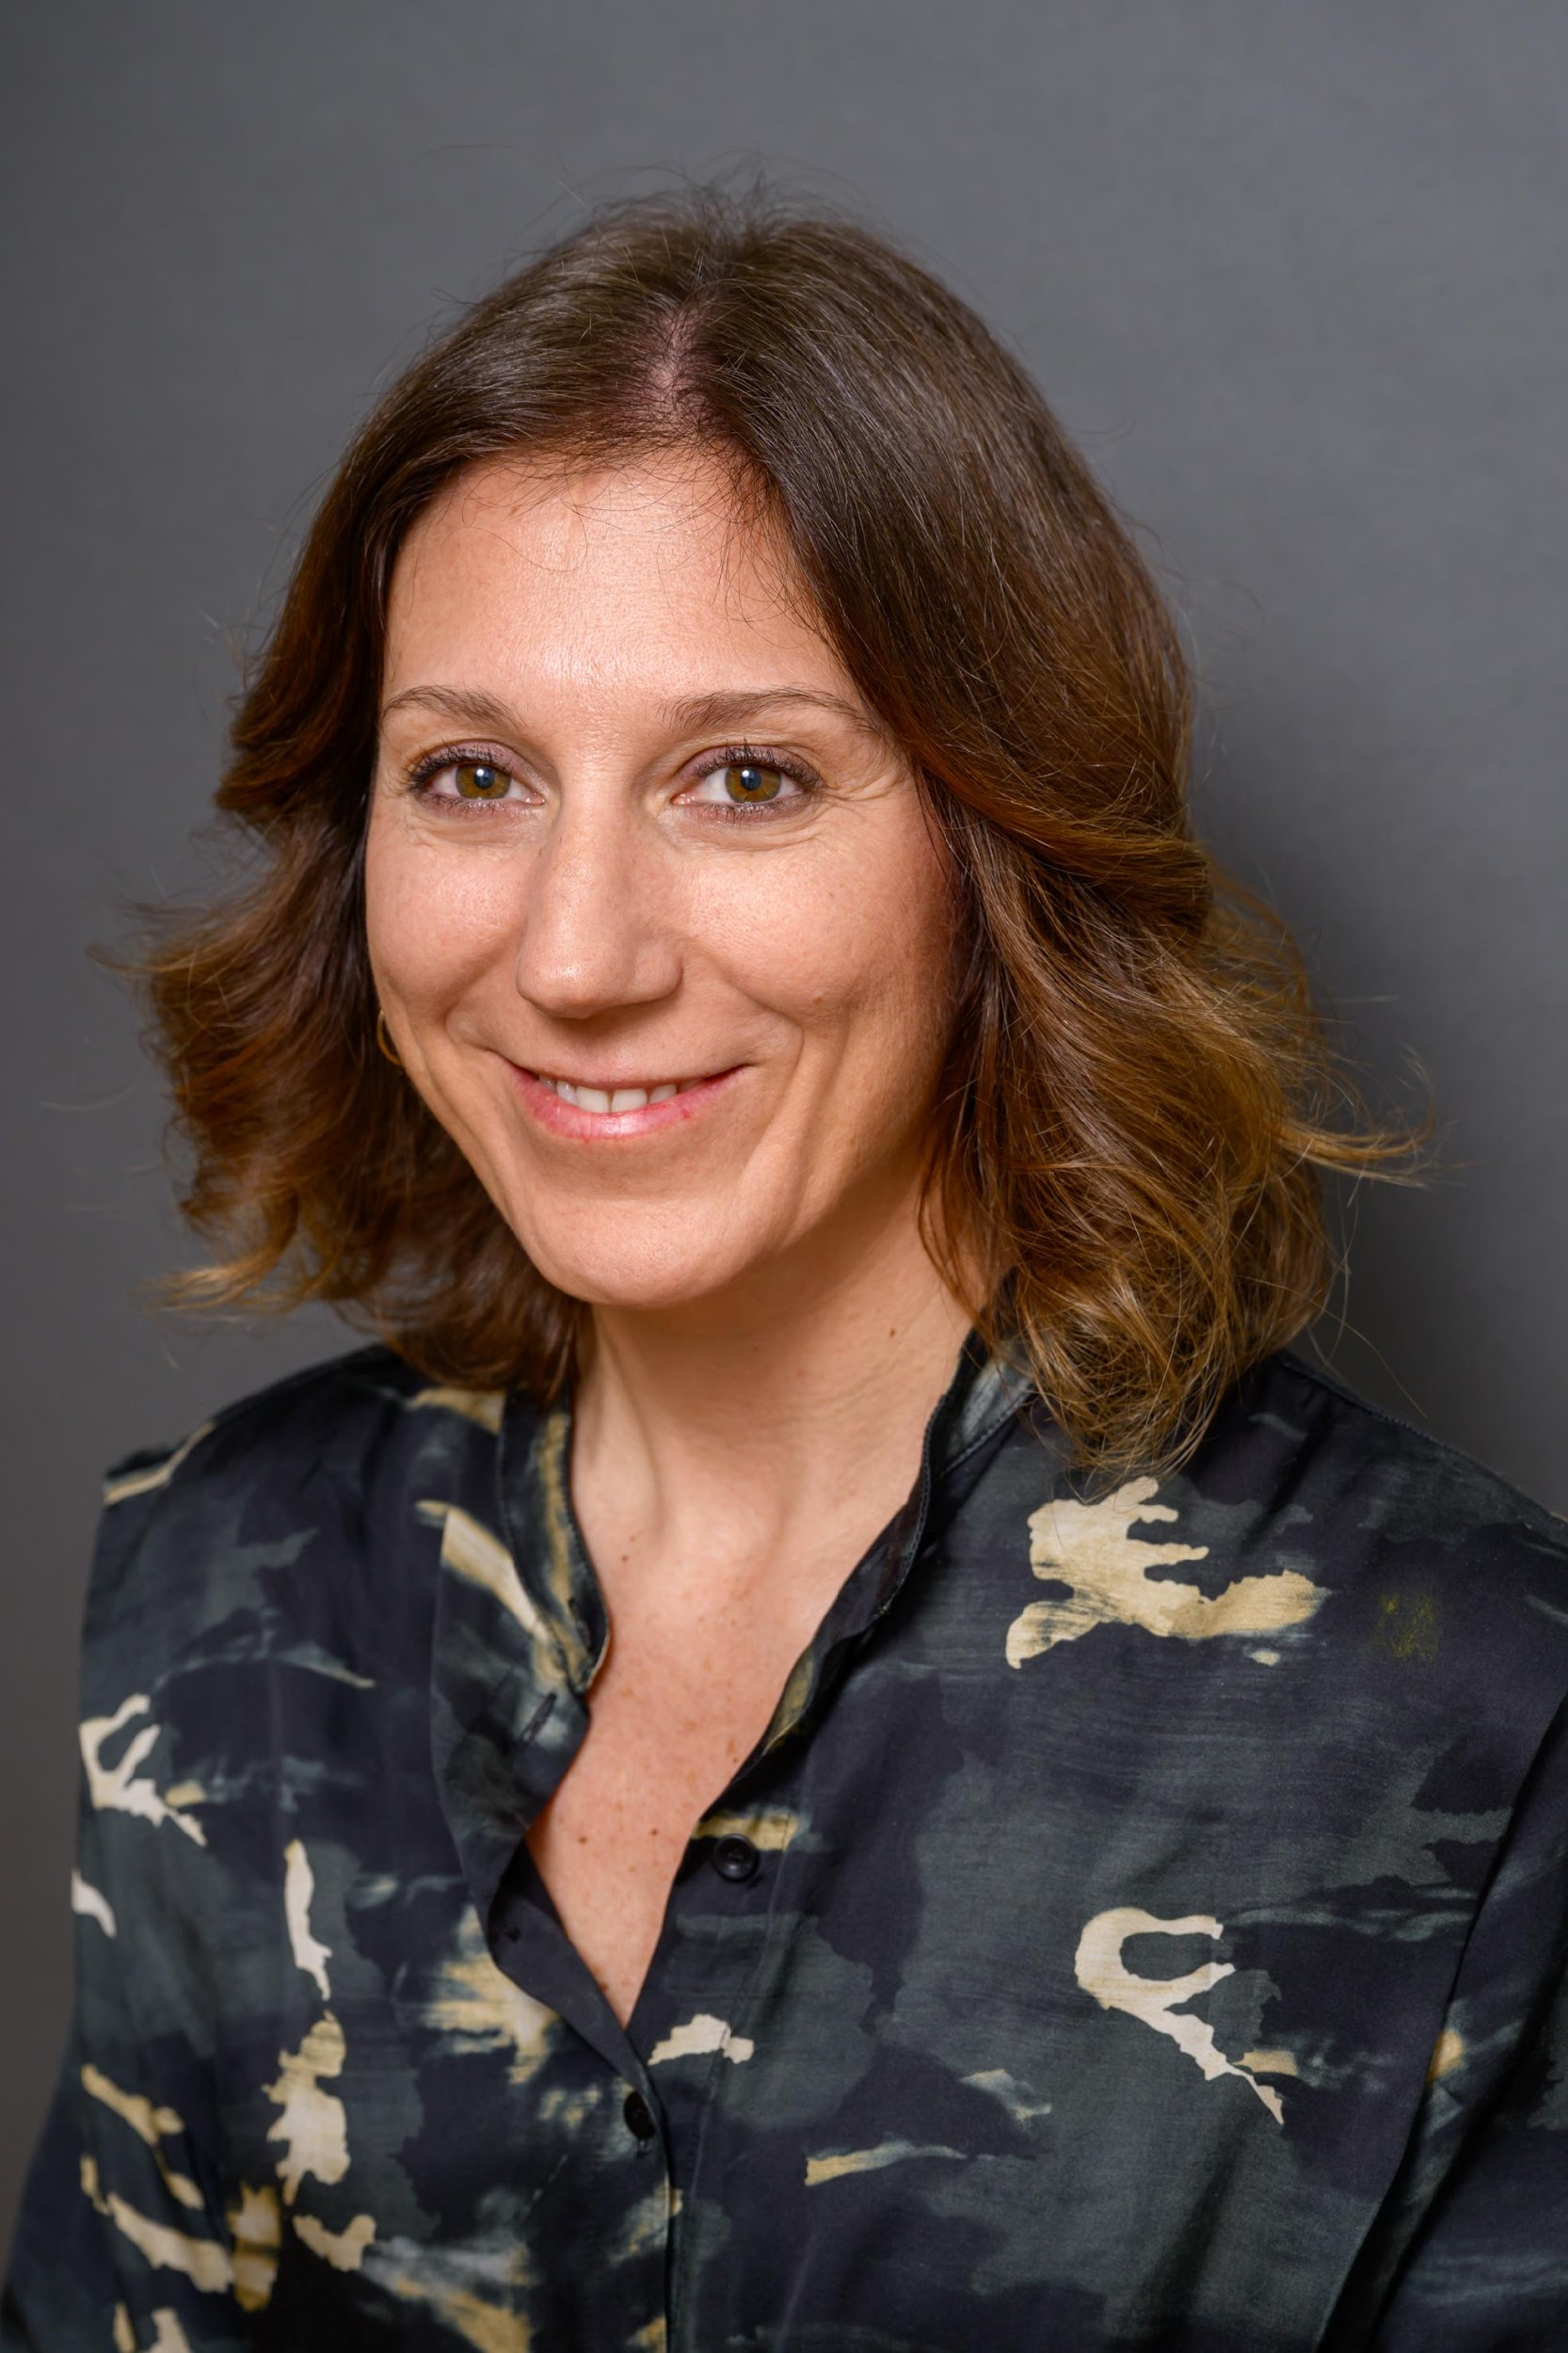
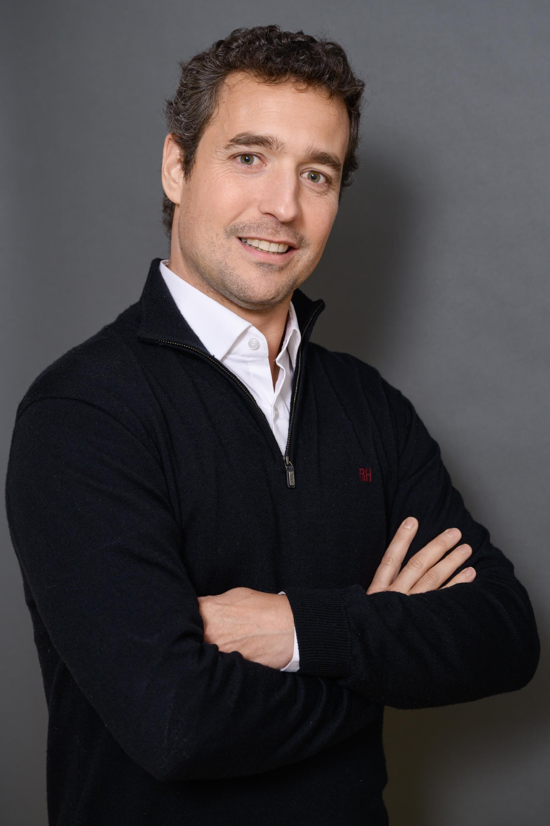
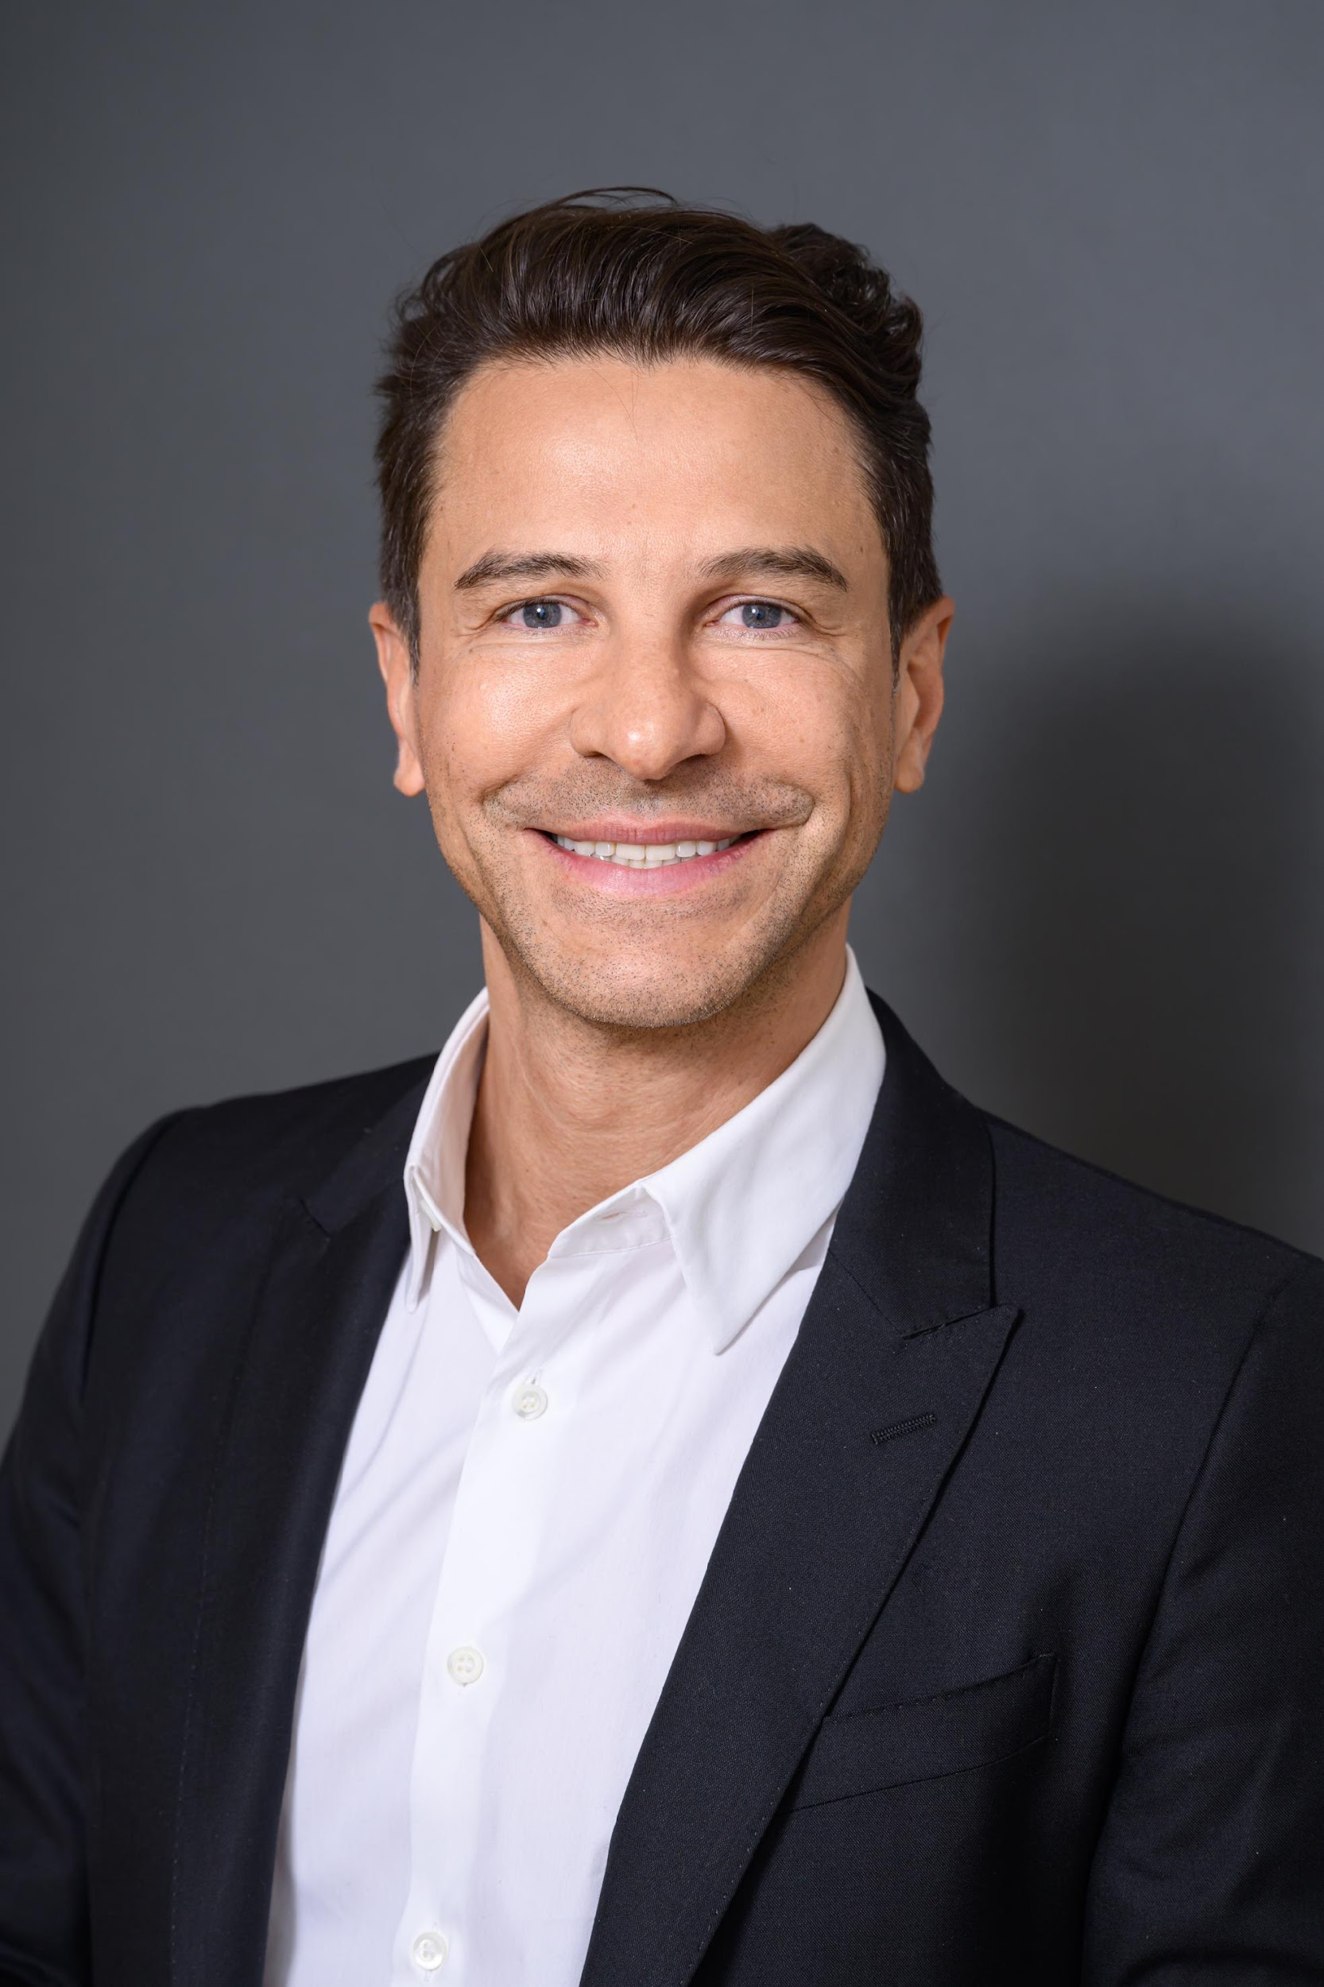
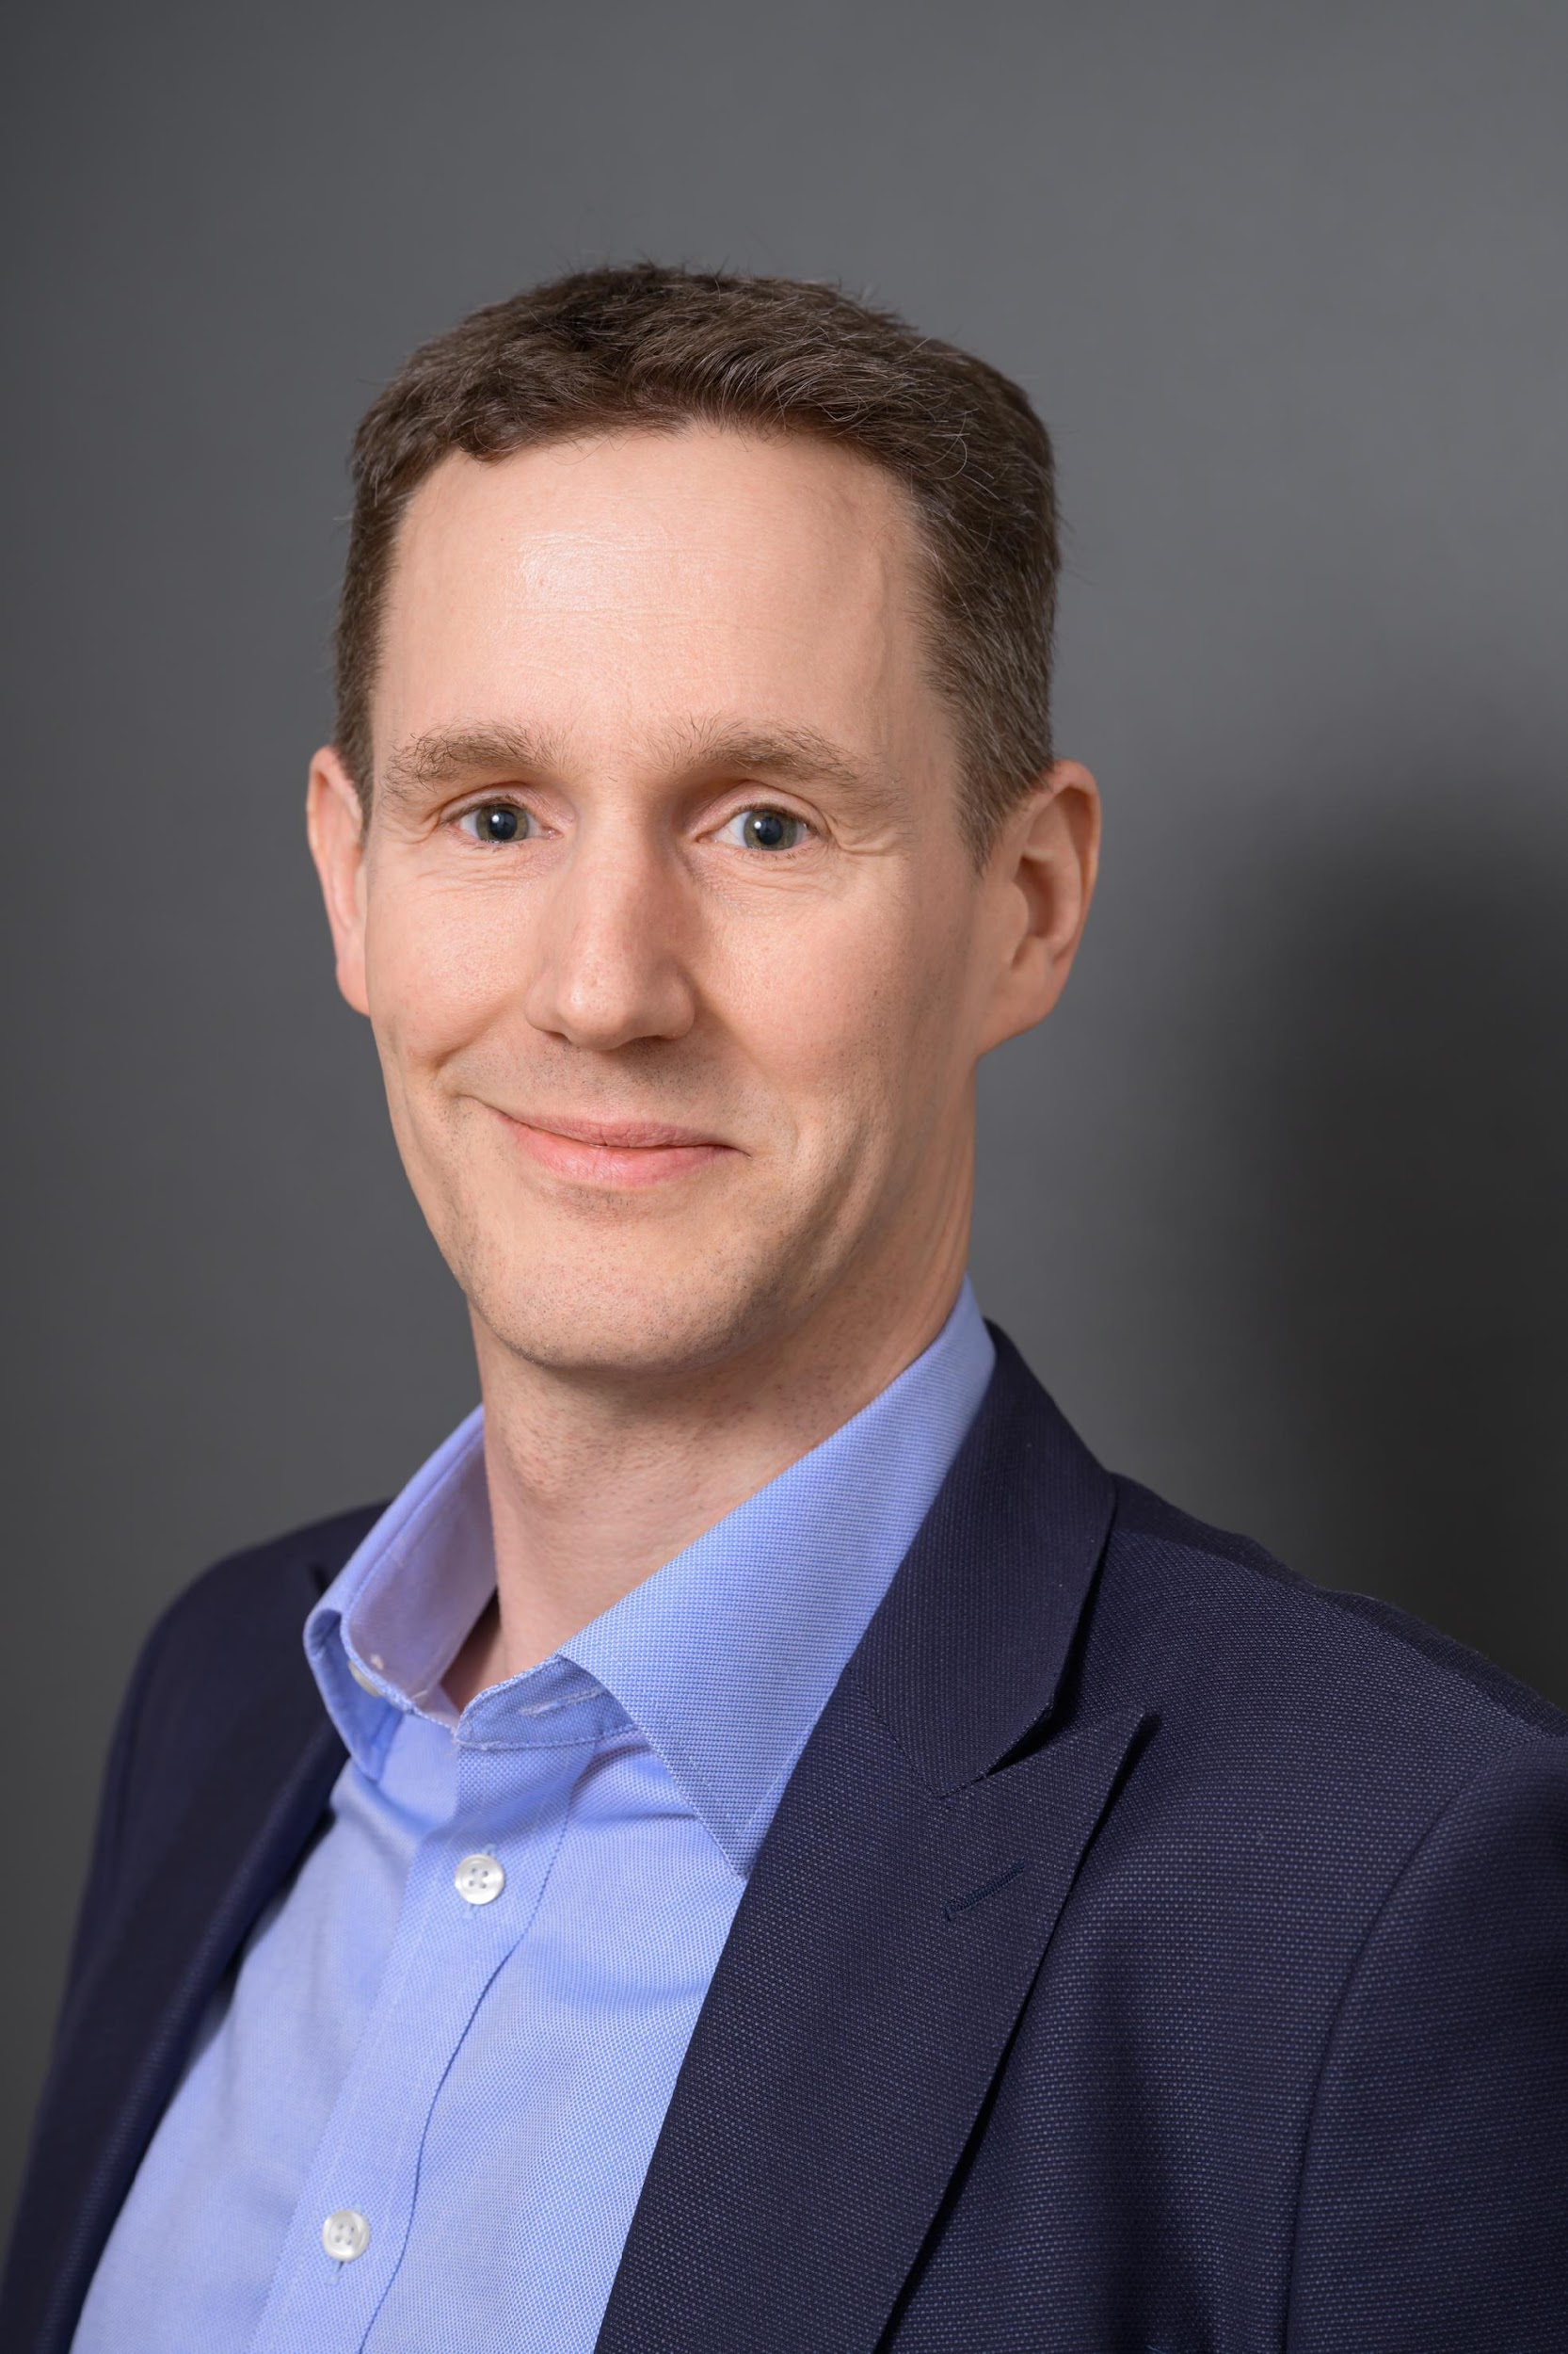
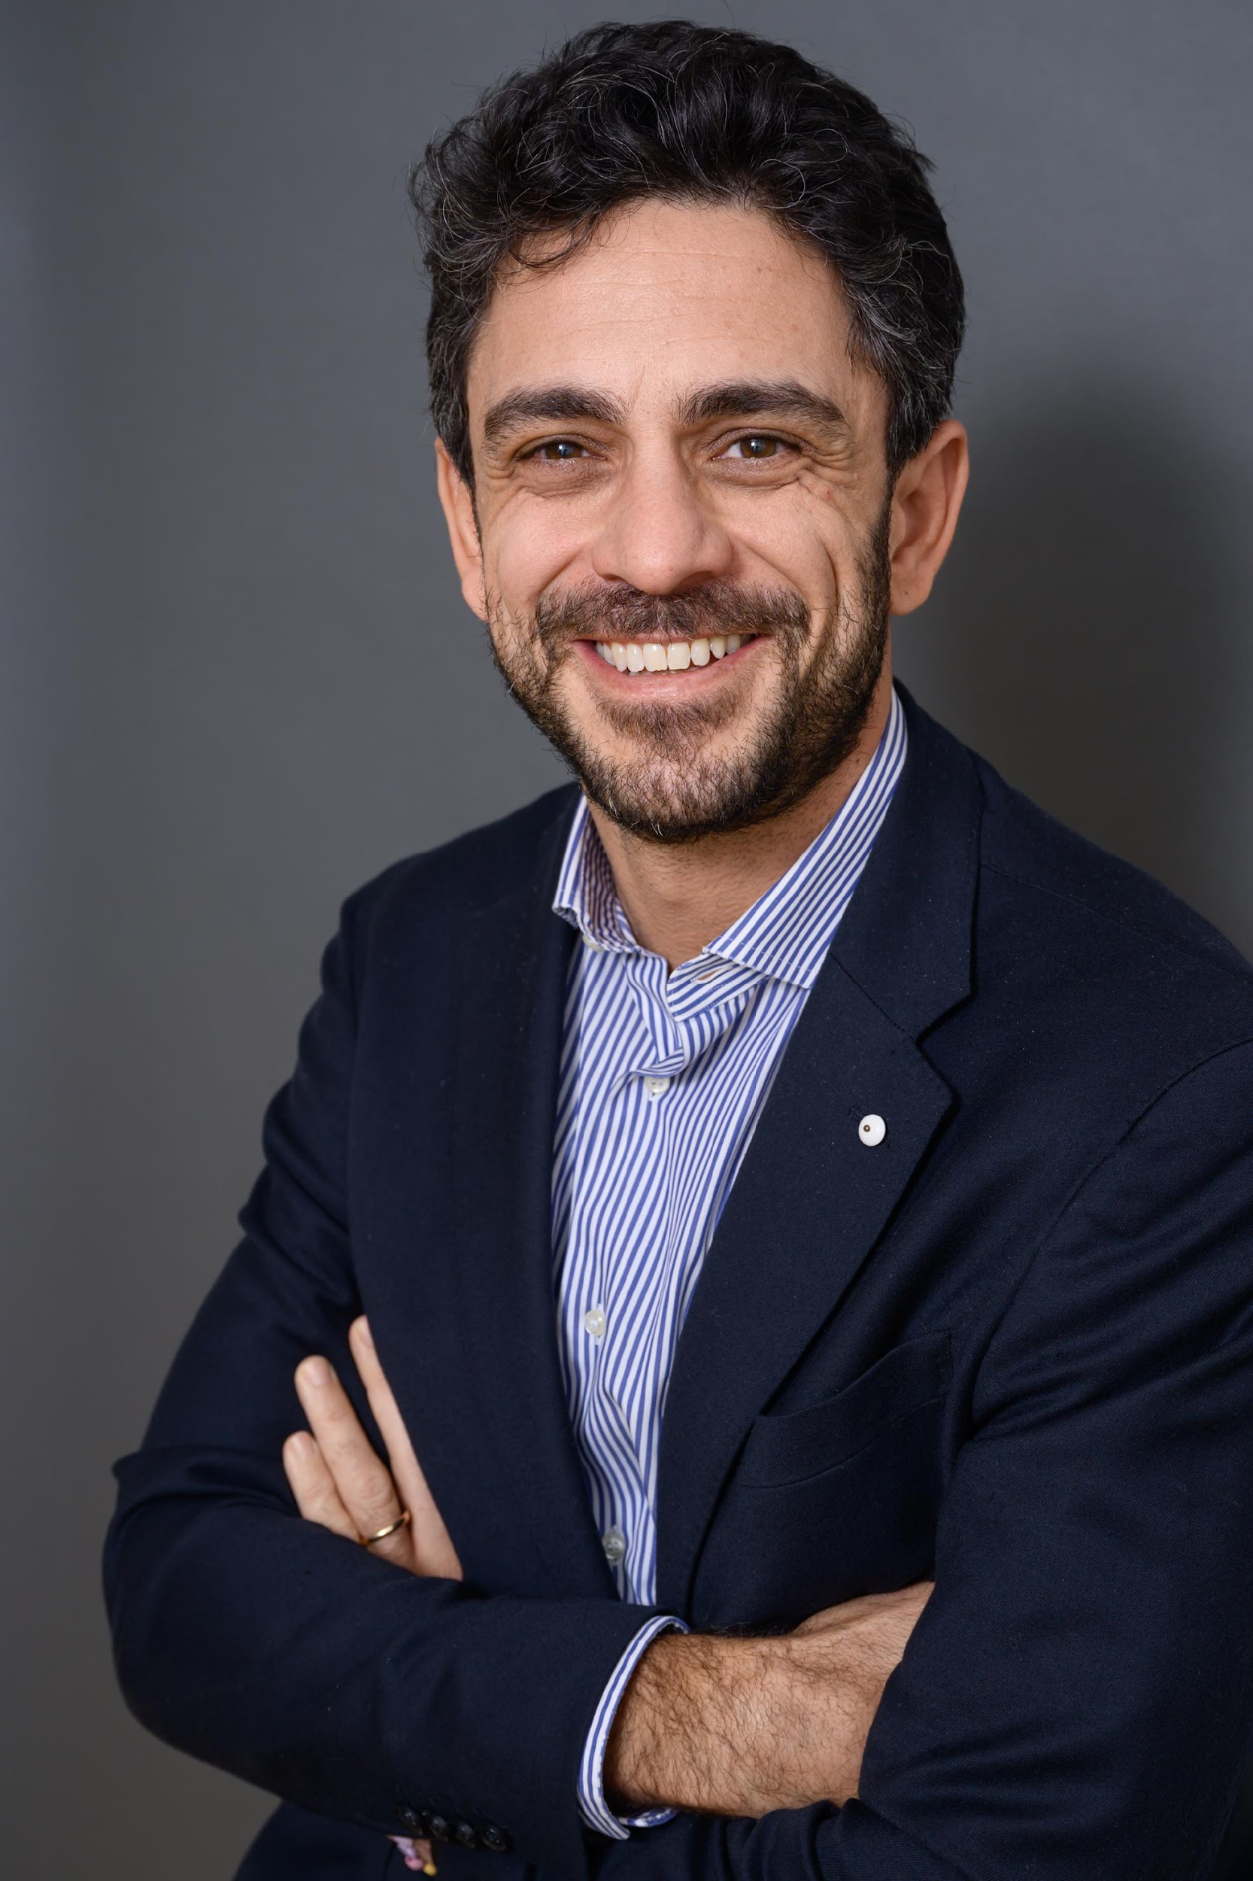
Team
Leveraging ESCP’s EMBA participants and ICP to accelerate Re-New,
moving from a self-funded MVP
to a self-standing profitable business on an attractive market
Re-New 1.0
Re-New 2.0
Laying the foundations
Ideation, Business Research,
MVP testing & building
Supporting growth ambitions
Refine and scale existing, Pilot & test new concepts, support go-to-market
Notes:
Amelie:
Re-New was initiated by a core team of five Executive MBA participants at ESCP, combining diverse functional backgrounds and a shared ambition to tackle the SME transmission challenge.
Bertrand Galas led the project, drawing on 20+ years of experience in transformation and complex program delivery to ensure structure, pace, and strategic clarity.
Amélie Lyon, a senior HR leader, designed our proprietary candidate selection process and led the talent and leadership workstream.
Antoine Duchêne, CFO and entrepreneur, developed our financial structuring and crafted the Support Package—our core differentiator.
Francesca Mapelli, PhD in Corporate Sustainability, embedded ESG across all dimensions of the programme.
Catherine Merrin shaped our brand strategy and communications, positioning Re-New as a credible and actionable initiative.
The team worked with complementary MBTI and Belbin profiles, balancing vision, structure, adaptability, and drive. Despite diverse styles, mutual trust and purpose enabled effective collaboration.
To build on this foundation, a second team of EMBA participants is now joining the adventure.Ivan, Gabriele, Ignacio, Alexandre, and Piera bring fresh capabilities across strategy, M&A, operations, finance, and ESG innovation.
They will contribute to scaling Re-New’s acceleration programme while continuing the entrepreneurial momentum. Their role will be to explore new territories—whether in business models, partnerships, or international development—ensuring Re-New keeps evolving as a dynamic and forward-looking initiative.This smooth transition allows Re-New to grow from a strong foundation, while staying true to its mission.

Slide 12


And now… To be continued !
A Dream written-down becomes a Goal
A Goal broken-down into steps becomes a Plan
A Plan backed by actions becomes Reality
Re-New 2.0
4
Notes:
Bertrand
Before moving to the Q&A, we need a proper conclusion.
I will start by thanking you, jury for your support throughout the ICP and for your attention today. We look forward to your questions and of course all constructive feedback you can provide us with.
Also, I’d like to thank the team for their amazing work over these 12 months – Coeur avec les doigts
And I would like now to close our ICP, with a quote that we used to open our 1st meeting together =>
The reality is that the Re-New company will be launched this month !
It is already backed by 4 Angel Investors from our cohort !
The ICP 2.0 team is being onboarded right now !
And we plan to collaborate as much as possible with ESCP community and network to make this venture even more successful, and ensure this benefits both to the recognition of our EMBA programme, and to ESCP as a whole.
Thank you for your attention !

Slide 13
Q&A
June 5, 2025
https://www.re-new.team/
https://www.linkedin.com/company/re-new-reprenez-transformez/
contact@re-new.team
Notes:
“In summary, Re-New addresses a massive, under-served market with a compelling, scalable solution. Our rigorous selection, modular support, and ecosystem orchestration set us apart from competitors. We are uniquely positioned to capture the micro-cap SME transmission opportunity, drive sustainable value creation, and build a trusted brand in this space. Our experienced team, validated model, and clear roadmap give us the confidence to deliver on this vision. We invite you to join us in shaping the future of SME succession and sustainable entrepreneurship in Europe. Thank you for your attention—we look forward to your questions and to exploring how we can partner together.”

Slide 14
Appendixes
https://www.re-new.team/
https://www.linkedin.com/company/re-new-reprenez-transformez/
contact@re-new.team

Slide 15
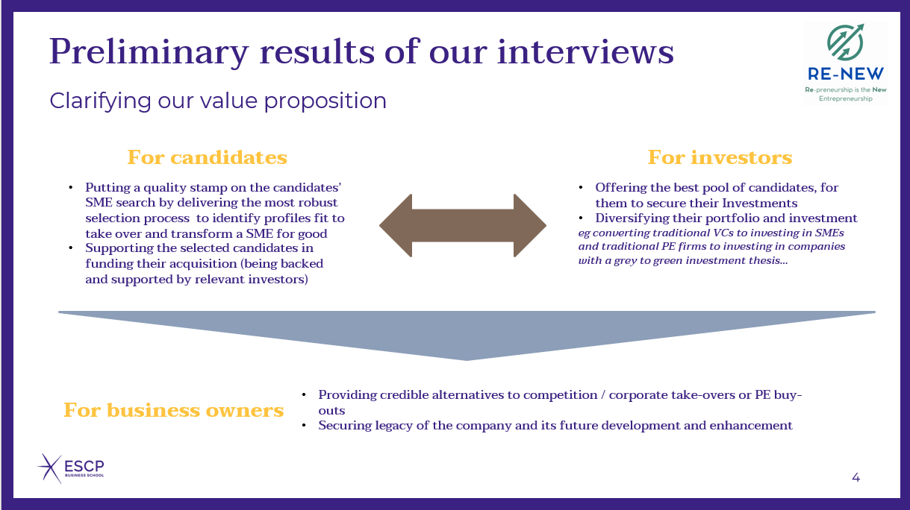
Appendix 1 – Revised value proposition

Slide 16
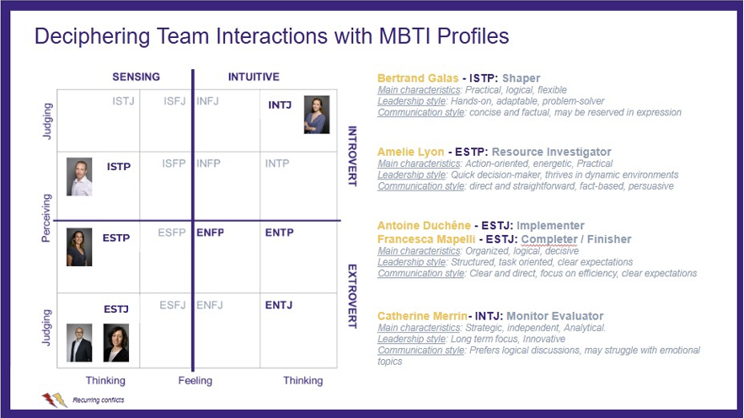
Appendix 2 – Re-New Team MBTI profiles

Slide 17
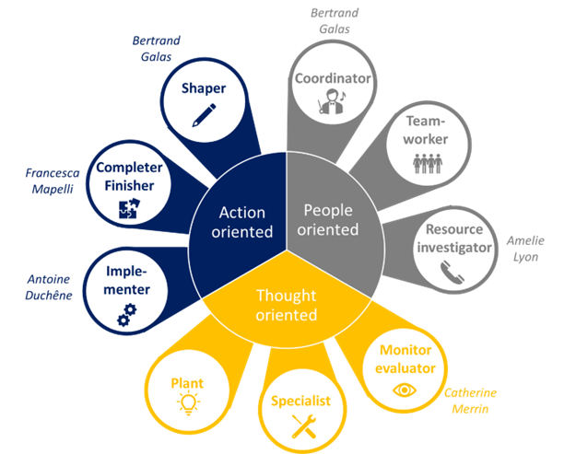
Appendix 3 – Re-New Team Belbin profiles

Slide 18
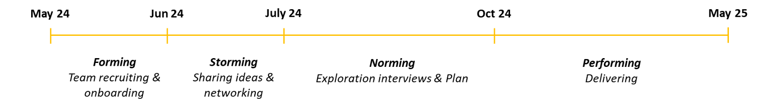
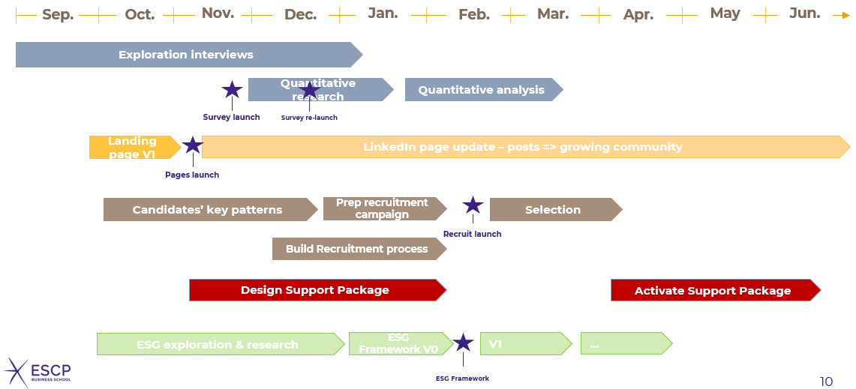
Appendix 3 – Team dynamics & project timeline

Slide 19
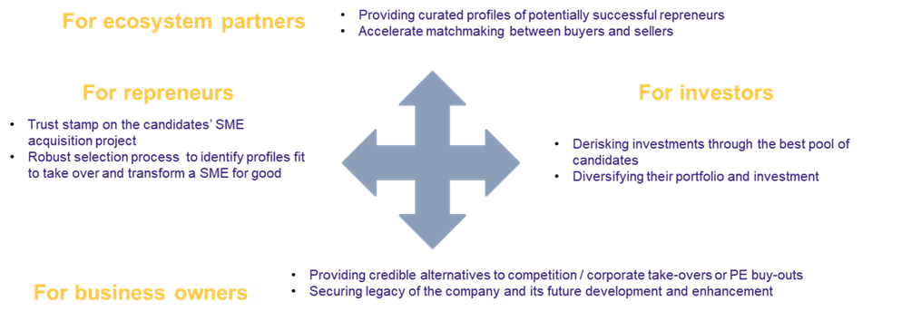
Appendix 4 – Key stakeholders and value prop°

Slide 20
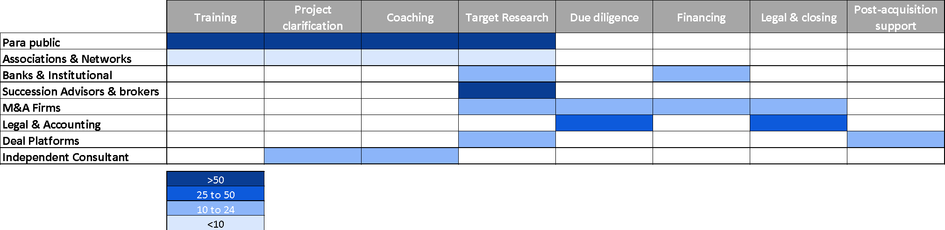
Appendix 5 – Market Map

Slide 21
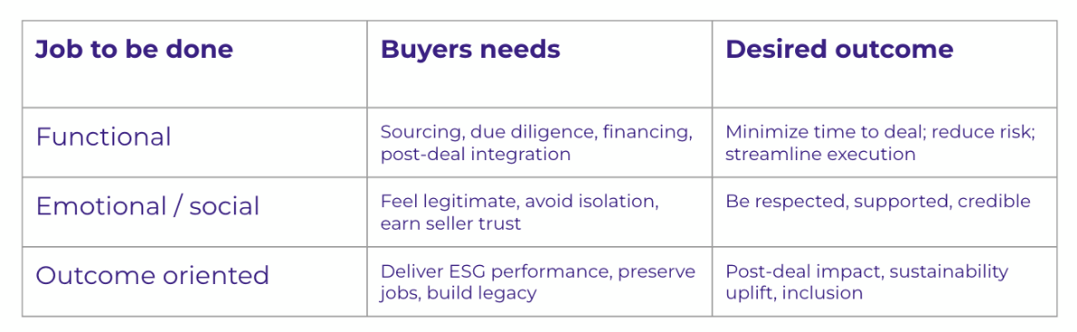
Appendix 6 – Job to be done

Slide 22
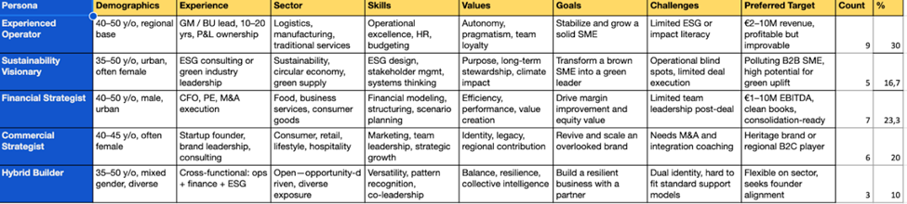
Appendix 7 - Personas

Slide 23
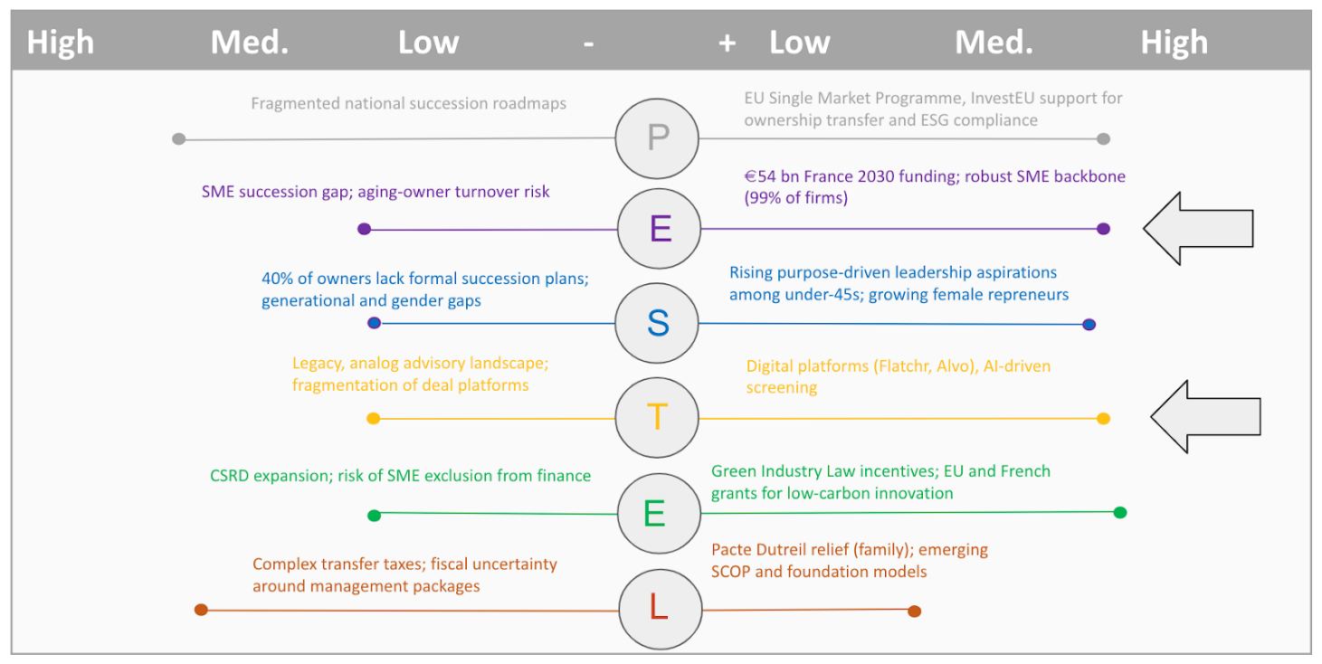
Appendix 8 – PESTEL Analysis

Slide 24
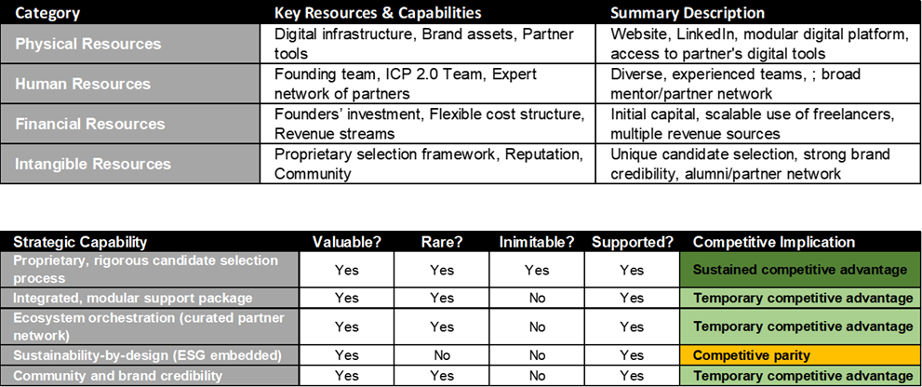
Appendix 9 – Strategic capability, resources and VRIO

Slide 25
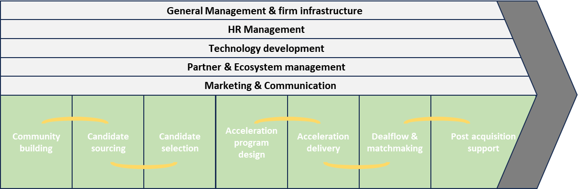
Appendix 10 – Value Chain analysis

Slide 26
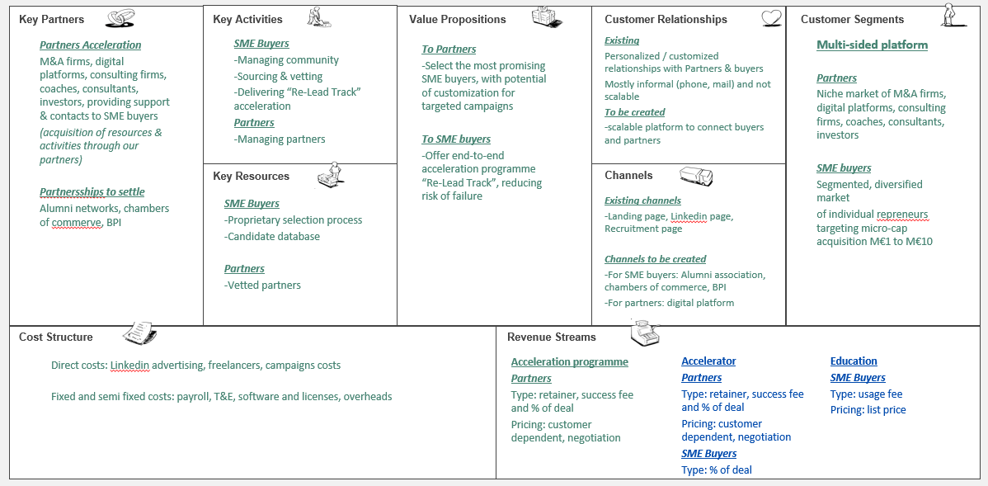
Appendix 11 – Business Model Canvas

Slide 27
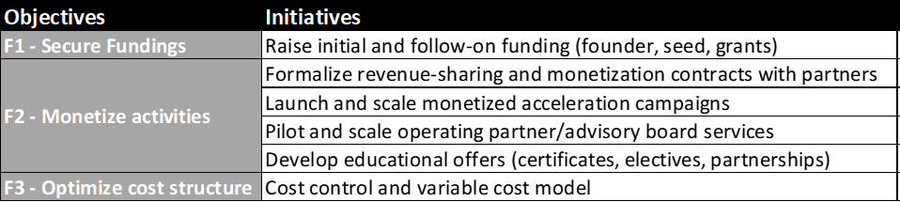
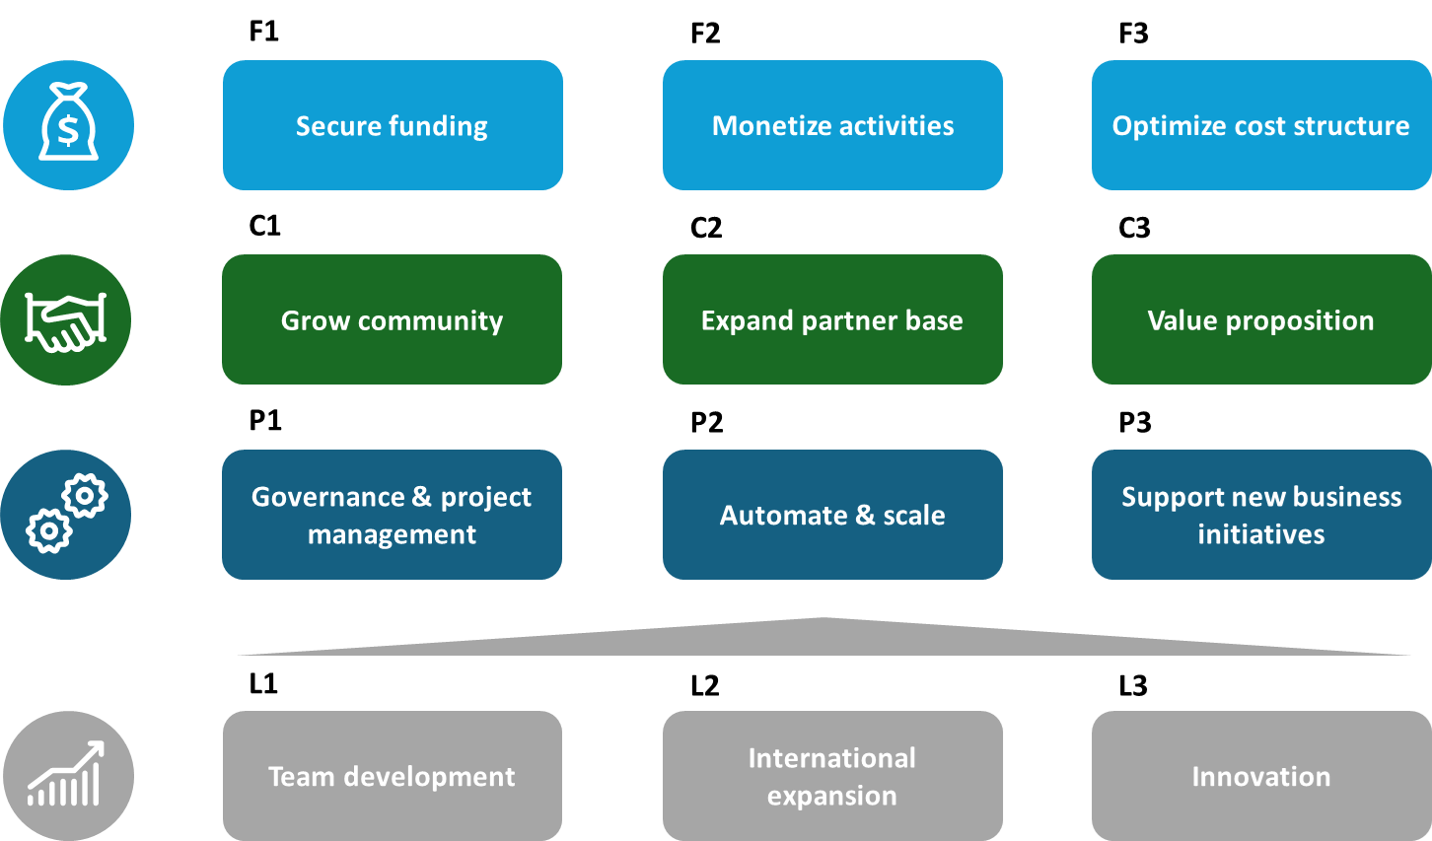
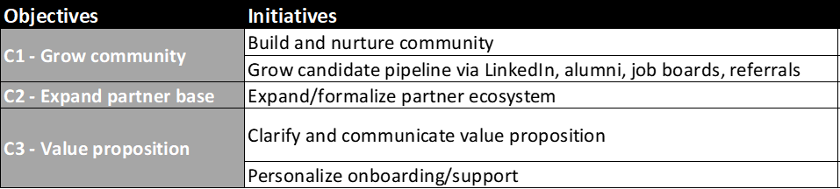
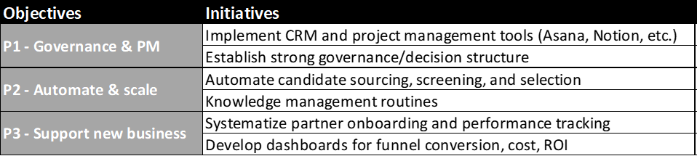
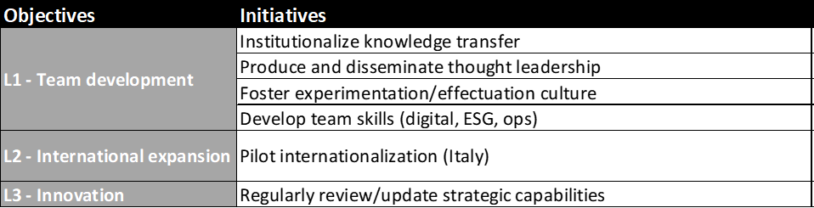
Appendix 12 – Strategy Map & key initiatives

Slide 28
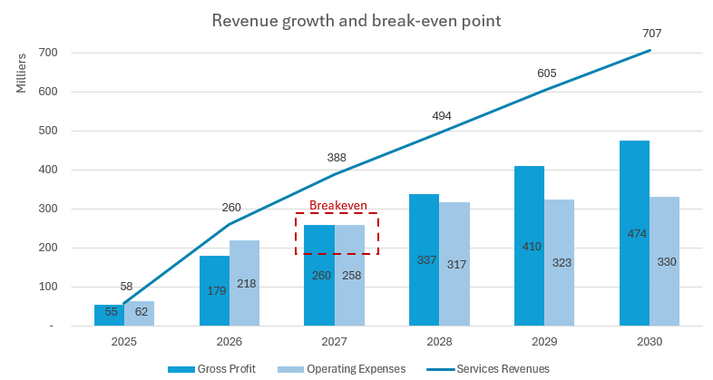
Appendix 13 –Break-even Analysis

Slide 29
Appendix 14
Slidedeck – extended version
https://www.re-new.team/
https://www.linkedin.com/company/re-new-reprenez-transformez/
contact@re-new.team

Slide 30
Company Purpose
Preserving economy by facilitating micro-cap SME transmission and accelerating their digital and environmental transformation
Service
Problem
Vision
Accelerating SME transmission through rigorous selection, preparation and customized support of individual SME buyers
Fragmented, complex, inefficient SME transmission market, where buyers lack support to succeed and fail 40% of attempts, and sellers struggle to find the right buyers.
Become the Y Combinator for SME transmission in Europe, empowering sustainable renewal and growth across the real economy.

Slide 31
Problem
An overly inefficient SME transmission market impacting negatively all stakeholders
-Lack of preparation
-Difficulty to find suitable successor
Missed opportunities
-A fragmented and opaque deal flow
-An overwhelming process
-Isolation & lack of support
Sellers
Buyers
-Difficulty to find bankable buyers
-De-risk portfolio
Value loss
Investors
Notes:
Catherine
Thousands of micro-cap SMEs today face a broken transmission process that hurts everyone involved. Aspiring buyers struggle with deal flow that’s both fragmented and opaque. They may know a business exists for sale, but finding reliable, off-market opportunities is nearly impossible. Even when a target is identified, the process becomes overwhelming. Conducting valuations, coordinating due diligence, handling legal negotiations, and securing financing often falls entirely on their shoulders, without a clear roadmap or centralized support. As a result, many promising buyers abandon their search before closing a deal, deterred by complexity and cost.
At the same time, SME owners often lack preparation for succession. They have no structured plan or timeline, which turns finding a suitable successor into a daunting task. Without professional guidance or a pipeline of vetted buyers, sellers face the real risk of handing their life’s work to someone ill-equipped to run it, or worse, closing down altogether.
Investors—banks, private equity, and family offices—are similarly challenged. They cannot easily determine which buyers are truly “bankable,” creating mistrust around a buyer’s ability to complete the transaction and operate the business successfully. With limited visibility into buyer readiness, investors hesitate to underwrite deals, making financing scarce or expensive. This risk aversion forces many would-be transactions off the table.
Put together, these challenges lead directly to missed opportunities and value loss. Buyers give up, sellers retire without a proper handover, and investors hold capital on the sidelines. The net result: viable businesses shut down, jobs disappear, and local economies suffer. This broken ecosystem—where fragmented deal flow, an overwhelming acquisition journey, unprepared sellers, and risk-averse financiers collide—creates systemic failures that threaten the very continuity of thousands of SMEs.

Slide 32
Solution
The first structured acceleration program, connecting buyers, partners, experts and investors, and partners
Multi-step proprietary selection process
Modular acceleration program
Access to deal flow
-Increase probability of target search success
-Improve negation outcome
-Improve financing conditions
-Support company « grey-to-green » transformation
Coaching
Due diligence & legal
Financing
Attract & select the best
Connecting with partners
Support post-acquisition
Sustainability fully anchored from candidate selection to value creation
Notes:
320 words -
Re-New begins by rigorously identifying top aspiring repreneurs—those who combine industry experience, leadership skills, and a genuine commitment to long-term value creation. This selective vetting is not a luxury; it’s essential. It filters out underprepared buyers and focuses resources on individuals most likely to succeed.
Once candidates are chosen, they gain access to a curated pipeline of vetted, off-market SMEs. No more wandering through fragmented listings or opaque networks. This deal-sourcing layer transforms a guessing game into a predictable process—an antibiotic against the endless search effort that derails many buyers.
At the same time, each repreneur is paired with one-on-one coaching from seasoned operators and industry experts. This mentorship goes far beyond generic advice, diving into valuation methodologies, negotiation tactics, and operational blueprints.
Parallel to coaching, Re-New also integrates a network of trusted legal and due-diligence partners. Preferred arrangements with top advisory firms streamline contract drafting, regulatory compliance, and risk management. This coordinated, end-to-end legal and due-diligence solution replaces the expensive, piecemeal advisor patchwork that buyers typically face.
Financing is woven into the acceleration journey as well. Through established relationships with banks and alternative lenders, we secure bankable contacts that dramatically reduce capital uncertainty. Financing without our program is like driving blind; with Re-New, it’s a focused, lower-risk path to closing.
Crucially, support continues post-acquisition. Reprenuers receive ongoing coaching focused on digital modernization and ESG integration—the “grey-to-green” transformation that unlocks additional value. Embedding sustainability from day one turns each acquisition into a force for community and environmental good. This ensures Re-New isn’t just a nice-to-have aspirin—it’s the antibiotic the SME succession ecosystem desperately needs.
In short, Re-New’s end-to-end, fully structured acceleration program eradicates systemic pain points in SME transmission. It’s not an optional luxury or temporary remedy; it’s the essential cure that drives successful, sustainable business transitions.

Slide 33
Coopetition – partners and soon to be partners
Re-New’s unique acceleration programme offers the strongest support
A highly fragmented and analogic market with potential for offer aggregation and digitalization
Training
Project clarification
Coaching
Target Research
Due Diligence
Financing
Legal & closing
Post acquisition support
Re-New
Para public
Associations & Networks
Indirect
Legal & Accounting firms
Banks & institutional
M&A Firms
Brokers
Direct
Deal platforms
Experts /Consultants
+
# of players involved
-
Notes:
The SME transmission landscape is highly fragmented. A range of indirect and direct players each tackle isolated parts of the challenge, but none provide a truly integrated solution tailored to individual buyers.
Re-New fills that gap. We offer a full-stack approach that combines rigorous deal selection, modular end-to-end support, and an engaged community of peers and experts. Our platform is designed to make SME acquisition accessible, transparent, and effective, especially for the new generation of entrepreneurial buyers.
We range from indirect support, to project clarification, coaching and target research, through the support of public and private entities. We also provide direct support, in due diligence, financing and legal aspects, until post acquisition, thanks to our network of banks and institutions, M&A firms, brokers and deal platforms.
Hence, Re-New’s unique acceleration programme offers the strong support for selected repreneurs.
OLD
The SME transmission ecosystem is fragmented, with diverse indirect and direct competitors all addressing parts of the problem.
However, none offer a full, integrated solution for individual buyers—combining rigorous selection, modular support, and a vibrant community.
Re-New’s platform approach and sustainability focus set us apart. Our early-mover advantage in the micro-cap segment and our curated partner network make us the trusted orchestrator in this space. We are building the reference brand for SME buyers and partners alike.

Slide 34
Why now ?
The perfect storm for SME transmission: we are at the crossroads of several powerful trends, and the process remains complex and under-served.
SME owners aged 55+ in France growing from 45% in 2015 to 65% in 2030
700,000 businesses need to find new leaders by 2030
Same trend prevailing across Europe
~40% of French SMEs without internal successor
Family SME trasnmissions decreased to 20%, down from 30% a decade ago
DEMOGRAPHIC TRENDS
SUCCESSION WAVE
In 2024 the French Small Cap M&A segment grew by 27%
In Europe 450,000 businesses are transferred each year, but an alarming 150,000 transfers fail
Yet, the process is complex and fragmented, especially for individual buyers
UNDERSERVED MARKET
NEW GENERATION OF BUYERS
Motivated by independence, impact, and long-term ownership
Entrepreneurship through acquisition seen as a faster, less risky alternative to founding a new company

Slide 35
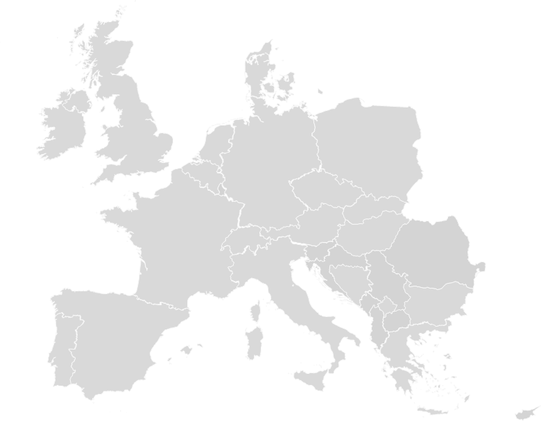
Market size
A large opportunity in France, and also across Europe
With a strong potential for growth due to demographic shifts driving up changes of ownership
TAM
TAM = All SMEs transfers in France = 60 000 / year
45% business owners >50 y.o
SAM
SAM = SMEs transfers valued M€1 to M€10, through individuals = 7 000 / year
SOM
25% business owners >60 y.o
SOM = 0.5% market = 35 / year
SAM = 3 500 / year
SAM = 1 500 / year
~15 000 transactions per year
Accelerating trend for SMEs transmission
SAM = 1 250 / year
SAM = 1 000 / year
Notes:
“The opportunity is immense. In France alone, there are 60,000 SME sales annually, with around 14,000 deals in the €1–10M range—the micro-cap segment we target. Of these, around 7,000 involve individual buyers, our primary audience.
This segment is growing, driven by demographic shifts, owner retirements, and a rising appetite for entrepreneurship through acquisition.
Yet, it remains under-served by traditional players.
Our approach is scalable across Europe, where similar trends and gaps exist. If we capture even a modest share of this market, the upside is substantial, both in terms of impact and financial return. Our business model is designed to scale as the market grows, with clear pathways to expand into new geographies and adjacent services.”

Slide 36
Product Development roadmap
Q2 25
Q3 25
Q4 25
Q1 26
Q2 26
Q3 26
Q4 26
Q1 27
Q2 27
2,000
6,000
9,000
Grow community
12
15
20
Support ecosystem – paying partners
Digital platform
Acceleration
Develop targeted campaigns
Automate & scale sourcing, screening & selection – iteration #1
Automate & scale sourcing, screening & selection – iteration #2
Test Advisory model
Advisory
Deploy Operating Partner & Advisory model
Test training model
Build training content
Roll-out training
Training
Training model go-to-market
Test Accelerator model
Go / No-go
Test Fund model
LT vision
Go / No-go
Notes:
Bertrand
A more detailed roadmap in appendix
Acceleration : our acceleration programme is at the core of Re-New ; continuous improvement of our processes, automation and digitalization are part of our plans to scale it. So is the growth of monetized partners, we plan to grow from 9 today, to 20 in 27
Advisory : The Operating Partner model is gaining traction in Europe, we do need to test this and build a small community of SME experts to help buyers create value. Also, we need to position Re-New as a trusted board member of SMEs acquired by our candidates
Training: only a handful of organizations provide repreneurship training, we believe that a solid and recognized program, endorsed by top-tier business school would be a key differentiator, and we plan to deliver on this
Long term vision: we have partners with whom we can test the accelerator model, and the fund model, we will capitalize as much as possible on this to try and create a very unique and new offer in the market

Slide 37
Business Model
A Business model with potential for diversification
to multiply monetization touchpoints and increase ARPU
Candidate selection
Training
Target Research
Deal closing
Financing
Post acquisition
Short term
Acceleration Model
Success fee
Success fee
Deal %
Deal %
Mid term
Advisory Model
Service fee
Education Model
usage fee
Long term
Accelerator / Fund Model
Deal %
Deal %
Management fees & carried interest
Notes:
Antoine:
A Business model with potential for diversification to multiply monetization touchpoints and increase Average Revenue Per User
Initiated acceleration model – currently proving monetization ; possible to sell candidates on-demand or monetize them at different touchpoints depending on the partner.
Then we have 2 service models we would like to test mid-term ; advisory model with operating partners post acquisition, and advisory board seats for the repreneurs
+ Education model, as it’s a very fragmented and inconsistent environment where associations, networks, and likedin gurus try to sell content ; and where potentially more can be done, with a rosk solid methodology backed by the best business school
Even though it’s a long term vision we will test it very rapidly, with the accelerator model and then the fund being our ultimate goal ;

Slide 38
Financials
We projected ambitious yet conservative financial targets
for our market entry, with a flexible cost-base
Revenue
CAGR
28%
K€ 710
2 education tracks in 2026, 20 in 2030
50 advisory days in 2026, 150 in 2030
K€ 260
Monetizing 11 candidates in 2026, 26 in 2030
EBITDA > 0 in 2027, Cash > 0 in 2028
Notes:
Antoine:

Slide 39
Team
Leveraging ESCP’s EMBA participants and ICP to accelerate Re-New,
moving from a self-funded MVP
to a self-standing profitable business on an attractive market
Re-New 1.0
Re-New 2.0
Laying the foundations
Ideation, Business Research,
MVP testing & building
Supporting growth ambitions
Refine and scale existing, Pilot & test new concepts, support go-to-market
Notes:
Amelie:
Re-New was initiated by a core team of five Executive MBA participants at ESCP, combining diverse functional backgrounds and a shared ambition to tackle the SME transmission challenge.
Bertrand Galas led the project, drawing on 20+ years of experience in transformation and complex program delivery to ensure structure, pace, and strategic clarity.
Amélie Lyon, a senior HR leader, designed our proprietary candidate selection process and led the talent and leadership workstream.
Antoine Duchêne, CFO and entrepreneur, developed our financial structuring and crafted the Support Package—our core differentiator.
Francesca Mapelli, PhD in Corporate Sustainability, embedded ESG across all dimensions of the programme.
Catherine Merrin shaped our brand strategy and communications, positioning Re-New as a credible and actionable initiative.
The team worked with complementary MBTI and Belbin profiles, balancing vision, structure, adaptability, and drive. Despite diverse styles, mutual trust and purpose enabled effective collaboration.
To build on this foundation, a second team of EMBA participants is now joining the adventure.Ivan, Gabriele, Ignacio, Alexandre, and Piera bring fresh capabilities across strategy, M&A, operations, finance, and ESG innovation.
They will contribute to scaling Re-New’s acceleration programme while continuing the entrepreneurial momentum. Their role will be to explore new territories—whether in business models, partnerships, or international development—ensuring Re-New keeps evolving as a dynamic and forward-looking initiative.This smooth transition allows Re-New to grow from a strong foundation, while staying true to its mission.

Slide 40
And now… To be continued !
A Dream written-down becomes a Goal
A Goal broken-down into steps becomes a Plan
A Plan backed by actions becomes Reality
Re-New 2.0
4
Notes:
Bertrand
Before moving to the Q&A, we need a proper conclusion.
I will start by thanking you, jury for your support throughout the ICP and for your attention today. We look forward to your questions and of course all constructive feedback you can provide us with.
Also, I’d like to thank the team for their amazing work over these 12 months – Coeur avec les doigts
And I would like now to close our ICP, with a quote that we used to open our 1st meeting together =>
The reality is that the Re-New company will be launched this month !
It is already backed by 4 Angel Investors from our cohort !
The ICP 2.0 team is being onboarded right now !
And we plan to collaborate as much as possible with ESCP community and network to make this venture even more successful, and ensure this benefits both to the recognition of our EMBA programme, and to ESCP as a whole.
Thank you for your attention !

Slide 41
Thank you
https://www.re-new.team/
https://www.linkedin.com/company/re-new-reprenez-transformez/
contact@re-new.team

